Slide 1

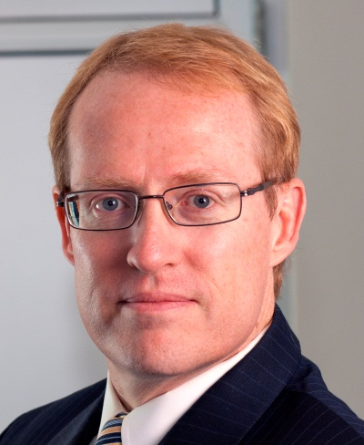



Overview of Pattern Relationships: Part 1
Douglas C. Schmidt
d.schmidt@vanderbilt.edu
www.dre.vanderbilt.edu/~schmidt
Professor of Computer Science
Institute for Software Integrated Systems Vanderbilt University Nashville, Tennessee, USA

Slide 2

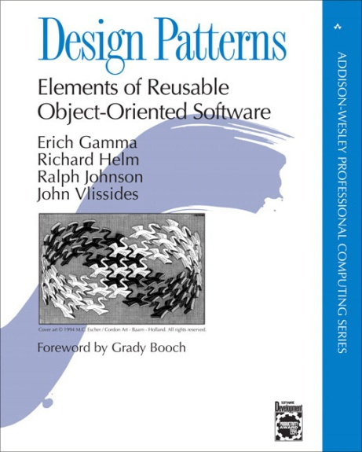

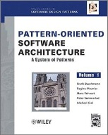
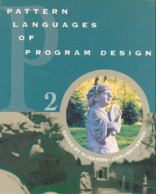
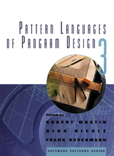
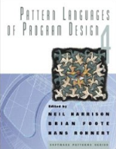

Topics Covered in this Part of the Module
Motivate the need for pattern relationships above & beyond pattern collections
Notes:
http://www.flickr.com/photos/38917708@N00/464804092/

Slide 3
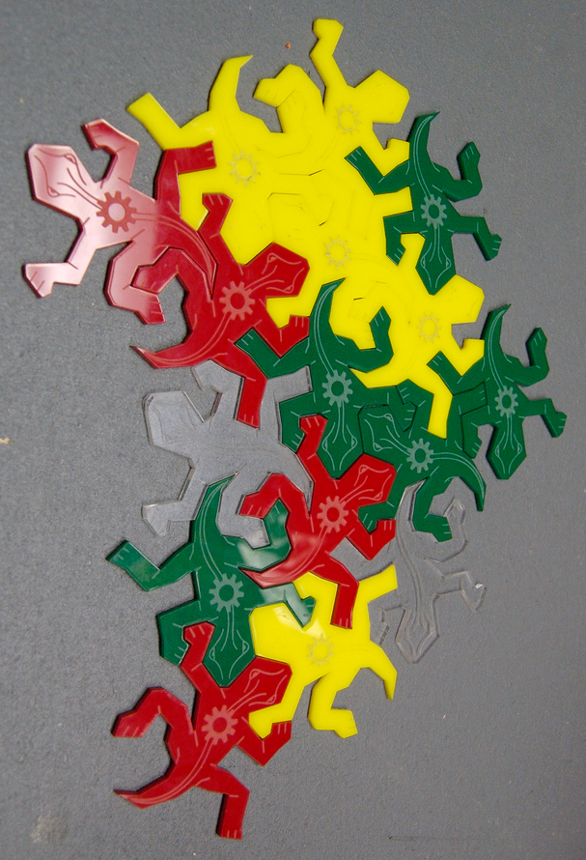
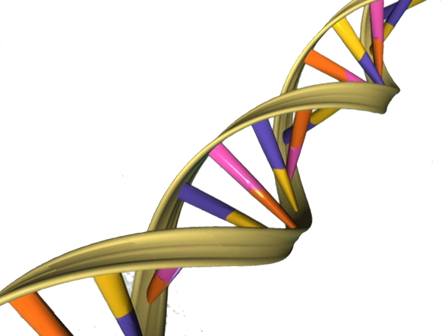
Topics Covered in this Part of the Module
Motivate the need for pattern relationships above & beyond pattern collections
Outline the common types of pattern relationships

Slide 4
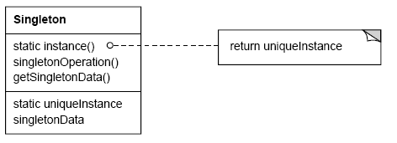
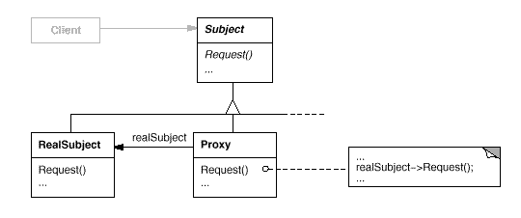
Overview of Pattern Collections
Stand-alone patterns provide “point solutions” to relatively bounded problems that arise within specific contexts
If (uniqueInstance == 0)
uniqueInstance = new Singleton;
return uniqueInstance;
Singleton pattern
Proxy pattern
See c2.com/cgi/wiki?SingletonsAreEvil for discussion of Singleton issues

Slide 5

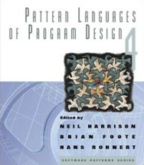
Overview of Pattern Collections
Stand-alone patterns provide “point solutions” to relatively bounded problems that arise within specific contexts
A common packaging of multiple stand-alone patterns is in the form of a “pattern collection”
e.g., GoF, POSA1, & Pattern Languages of Program Design (PLoPD) books

Slide 6

Overview of Pattern Collections
Stand-alone patterns provide “point solutions” to relatively bounded problems that arise within specific contexts
A common packaging of multiple stand-alone patterns is in the form of a “pattern collection”
e.g., GoF, POSA1, & Pattern Languages of Program Design (PLoPD) books
Stand-alone “pattern islands” are unusual in practice
Observer
Notes:
http://www.flickr.com/photos/30528809@N02/3382991517/

Slide 7
Overview of Pattern Collections
Stand-alone patterns provide “point solutions” to relatively bounded problems that arise within specific contexts
A common packaging of multiple stand-alone patterns is in the form of a “pattern collection”
e.g., GoF, POSA1, & Pattern Languages of Program Design (PLoPD) books
Stand-alone “pattern islands” are unusual in practice
Any substantial software design inevitably includes many patterns
Extension Interface
Publisher- Subscriber
Domain Object
Bridge
Active Object
Layers
Remote Operation
Component Configurator
Thread-Specific Storage
Evictor
Interceptor
Adapter
Interpreter
Proxy
Factory Method
Interpreter
Adapter
Facade
Activator
Monitor Object
Acceptor- Connector
Forwarder/ Receiver
Strategy
Leader/Followers
Reactor
Abstract Factory
Wrapper Facade
Component Configurator
Wrapper Facade
Half/Sync-Half/Async
Broker
Key challenge: How to best organize these patterns?

Slide 8
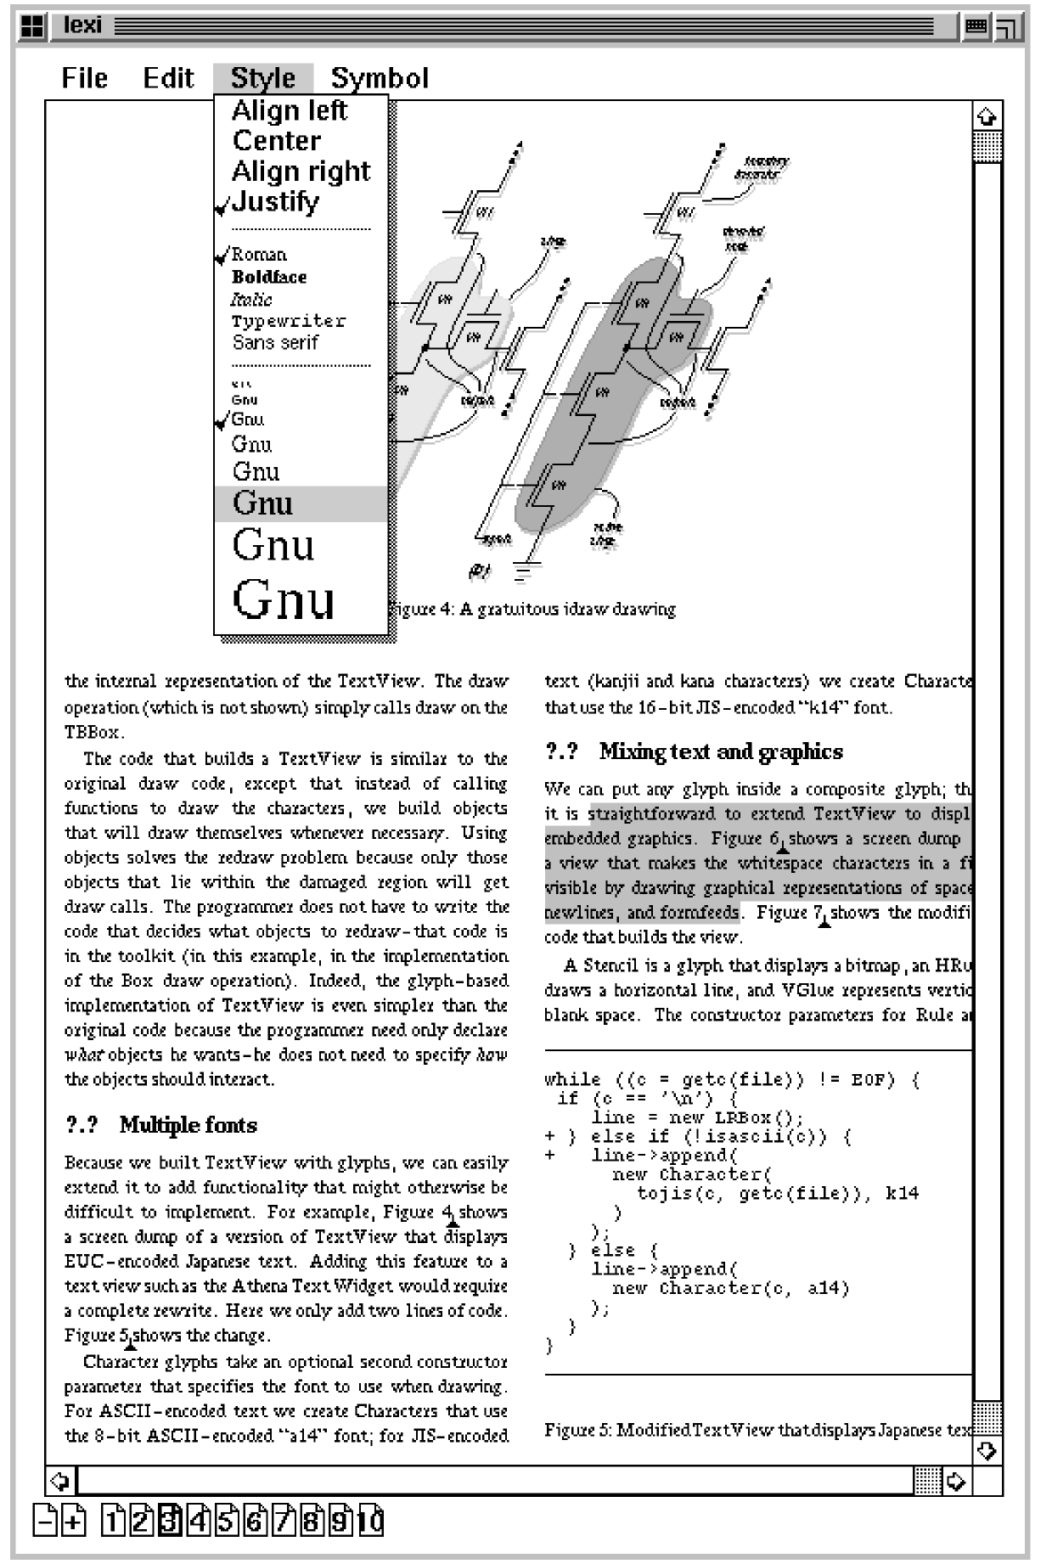
Overview of Pattern Relationships
Collections of stand-alone patterns have certainly been used with success
Design Problems
Document structure
Formatting
Embellishment
Multiple look & feels
Multiple window systems
User operations
Spelling checking & hyphenation
etc.
Notes:
http://www.flickr.com/photos/22177648@N06/2137737248/

Slide 9

Overview of Pattern Relationships
Collections of stand-alone patterns have certainly been used with success
Patterns are social, however, & like to work together
Reactor
Broker
Adapter
Proxy
Notes:
http://www.flickr.com/photos/22177648@N06/2137737248/

Slide 10
Overview of Pattern Relationships
Collections of stand-alone patterns have certainly been used with success
Patterns are social, however, & like to work together
Patterns commonly form the following types of relationships:
Patterns complements, where
one pattern provides missing ingredient needed by another

Slide 11

Overview of Pattern Relationships
Collections of stand-alone patterns have certainly been used with success
Patterns are social, however, & like to work together
Patterns commonly form the following types of relationships:
Patterns complements, where
one pattern provides missing ingredient needed by another
one pattern contrasts with another to provide an alternative solution to a related design problem

Slide 12
Overview of Pattern Relationships
Collections of stand-alone patterns have certainly been used with success
Patterns are social, however, & like to work together
Patterns commonly form the following types of relationships:
Patterns complements, where
one pattern provides missing ingredient needed by another
one pattern contrasts with another to provide an alternative solution to a related design problem
Pattern compounds capture recurring subcommunities of patterns that can be treated as a single decision in response to a recurring design problem

Slide 13
Overview of Pattern Relationships
Collections of stand-alone patterns have certainly been used with success
Patterns are social, however, & like to work together
Patterns commonly form the following types of relationships:
Pattern sequences join predecessor patterns with successor patterns to form part of their context

Slide 14
Overview of Pattern Relationships
Collections of stand-alone patterns have certainly been used with success
Patterns are social, however, & like to work together
Patterns commonly form the following types of relationships:
Pattern sequences join predecessor patterns with successor patterns to form part of their context
Pattern languages are networks of related patterns that define a process for the orderly resolution of (software) development problems in particular domains
en.wikipedia.org/wiki/Pattern_language has broader pattern language usages

Slide 15
Summary
Much existing literature on patterns is organized as pattern catalogs
Provides a good foundation, but more is needed
Notes:
http://www.flickr.com/photos/58925091@N00/166368185/

Slide 16
Summary
Much existing literature on patterns is organized as pattern catalogs
Provides a good foundation, but more is needed
Substantial software designs include many patterns, which are related to each other in various ways
Extension Interface
Publisher- Subscriber
Domain Object
Bridge
Active Object
Layers
Remote Operation
Component Configurator
Thread-Specific Storage
Evictor
Interceptor
Adapter
Interpreter
Proxy
Factory Method
Interpreter
Adapter
Facade
Activator
Monitor Object
Acceptor- Connector
Forwarder/ Receiver
Strategy
Leader/Followers
Abstract Factory
Reactor
Wrapper Facade
Component Configurator
Wrapper Facade
Half/Sync-Half/Async
Broker
Notes:
http://www.flickr.com/photos/58925091@N00/166368185/

Slide 17
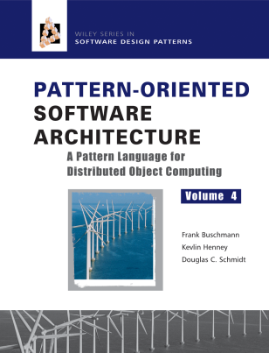
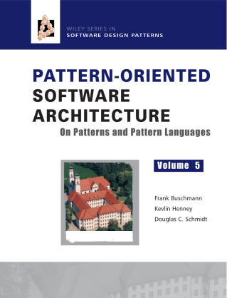
Summary
Much existing literature on patterns is organized as pattern catalogs
Provides a good foundation, but more is needed
Substantial software designs include many patterns, which are related to each other in various ways
A key challenge is to organize these patterns effectively
Extension Interface
Publisher- Subscriber
Domain Object
Bridge
Active Object
Layers
Remote Operation
Component Configurator
Thread-Specific Storage
Evictor
Interceptor
Adapter
Interpreter
Proxy
Factory Method
Interpreter
Adapter
Facade
Activator
Monitor Object
Acceptor- Connector
Forwarder/ Receiver
Strategy
Leader/Followers
Abstract Factory
Reactor
Wrapper Facade
Component Configurator
Wrapper Facade
Half/Sync-Half/Async
Broker
Notes:
http://www.flickr.com/photos/58925091@N00/166368185/

Slide 18
Overview of Pattern Relationships: Part 2
Douglas C. Schmidt
d.schmidt@vanderbilt.edu
www.dre.vanderbilt.edu/~schmidt
Professor of Computer Science
Institute for Software Integrated Systems Vanderbilt University Nashville, Tennessee, USA

Slide 19
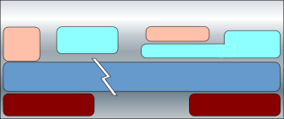
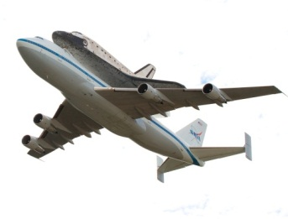
Topics Covered in this Part of the Module
Motivate the need for pattern relationships above & beyond pattern collections
Outline the common types of pattern relationships
Describe key concurrent & networked software patterns associated with the avionics domain
Subscribers
HUD
…
Air Frame
Nav
push(event)
Event Channel
push(event)
GPS
IFF
FLIR
Publishers
Board 1
VME
Board 2
1553

Slide 20
Motivating Example: Avionics Control Systems
Avionics Control System Functions
4: Mission
functions
perform
avionics
operations
Avionics control systems continuously
Collect sensor data to estimate actual state of an aircraft
Compute desired aircraft state with respect to guidance modes
Perform actions that advise pilots and/or directly manipulate aircraft effectors in ways that bring actual & desired state in closer agreement
Airframe & navigation (Nav)
Sensor management (GPS, FLIR, IFF)
Heads-up display (HUD)
Auto-pilot (AP)
etc.
3: Sensor
proxies
process data
& pass to
missions
functions
2: I/O via
interrupts
1: Sensors
generate
data
Board 1
VME
Board 2
1553
gee.cs.oswego.edu/dl/acs/acs/acs.html has info on avionics control systems

Slide 21
Motivating Example: Avionics Control Systems
Key Domain Characteristics
Hard & soft real-time deadlines
~20-40 times per second (Hz)
Avionics Control System Functions
4: Mission
functions
perform
avionics
operations
Airframe & navigation (Nav)
Sensor management (GPS, FLIR, IFF)
Heads-up display (HUD)
Auto-pilot (AP)
etc.
3: Sensor
proxies
process data
& pass to
missions
functions
2: I/O via
interrupts
1: Sensors
generate
data
Board 1
VME
Board 2
1553
www.dre.vanderbilt.edu/~schmidt/corba-research-realtime.html has more info

Slide 22
Motivating Example: Avionics Control Systems
Key Domain Characteristics
Hard & soft real-time deadlines
~20-40 times per second (Hz)
Low latency & jitter between processor boards
< 100 microseconds (µs)
Avionics Control System Functions
4: Mission
functions
perform
avionics
operations
Airframe & navigation (Nav)
Sensor management (GPS, FLIR, IFF)
Heads-up display (HUD)
Auto-pilot (AP)
etc.
3: Sensor
proxies
process data
& pass to
missions
functions
2: I/O via
interrupts
1: Sensors
generate
data
Board 1
VME
Board 2
1553
www.dre.vanderbilt.edu/~schmidt/corba-research-realtime.html has more info

Slide 23
Motivating Example: Avionics Control Systems
Key Domain Characteristics
Hard & soft real-time deadlines
~20-40 times per second (Hz)
Low latency & jitter between processor boards
< 100 microseconds (µs)
Periodic & aperiodic processing
Avionics Control System Functions
4: Mission
functions
perform
avionics
operations
Airframe & navigation (Nav)
Sensor management (GPS, FLIR, IFF)
Heads-up display (HUD)
Auto-pilot (AP)
etc.
3: Sensor
proxies
process data
& pass to
missions
functions
2: I/O via
interrupts
1: Sensors
generate
data
Board 1
VME
Board 2
1553
www.dre.vanderbilt.edu/~schmidt/corba-research-realtime.html has more info

Slide 24
Motivating Example: Avionics Control Systems
Key Domain Characteristics
Hard & soft real-time deadlines
~20-40 times per second (Hz)
Low latency & jitter between processor boards
< 100 microseconds (µs)
Periodic & aperiodic processing
Complex dependencies
Avionics Control System Functions
4: Mission
functions
perform
avionics
operations
Airframe & navigation (Nav)
Sensor management (GPS, FLIR, IFF)
Heads-up display (HUD)
Auto-pilot (AP)
etc.
3: Sensor
proxies
process data
& pass to
missions
functions
2: I/O via
interrupts
1: Sensors
generate
data
Board 1
VME
Board 2
1553
www.dre.vanderbilt.edu/~schmidt/corba-research-realtime.html has more info

Slide 25
Motivating Example: Avionics Control Systems
Key Domain Characteristics
Hard & soft real-time deadlines
~20-40 times per second (Hz)
Low latency & jitter between processor boards
< 100 microseconds (µs)
Periodic & aperiodic processing
Complex dependencies
Continuous platform upgrades
Avionics Control System Functions
4: Mission
functions
perform
avionics
operations
Airframe & navigation (Nav)
Sensor management (GPS, FLIR, IFF)
Heads-up display (HUD)
Auto-pilot (AP)
etc.
3: Sensor
proxies
process data
& pass to
missions
functions
2: I/O via
interrupts
1: Sensors
generate
data
Board 1
VME
Board 2
1553
www.dre.vanderbilt.edu/~schmidt/corba-research-realtime.html has more info

Slide 26
Motivating Example: Avionics Control Systems
Key Domain Characteristics
Hard & soft real-time deadlines
~20-40 times per second (Hz)
Low latency & jitter between processor boards
< 100 microseconds (µs)
Periodic & aperiodic processing
Complex dependencies
Continuous platform upgrades
Avionics Control System Functions
4: Mission
functions
perform
avionics
operations
Airframe & navigation (Nav)
Sensor management (GPS, FLIR, IFF)
Heads-up display (HUD)
Auto-pilot (AP)
etc.
3: Sensor
proxies
process data
& pass to
missions
functions
Avionics control systems are representative of distributed real-time & embedded (DRE) systems where robust concurrency & networking is critical to mission success
2: I/O via
interrupts
1: Sensors
generate
data
Board 1
VME
Board 2
1553
www.dre.vanderbilt.edu/~schmidt/corba-research-realtime.html has more info

Slide 27
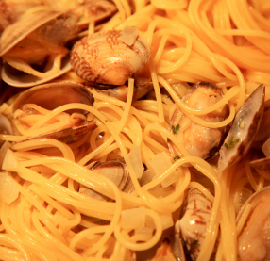
Motivating Example: Avionics Control Systems
Key Domain Characteristics
Hard & soft real-time deadlines
~20-40 times per second (Hz)
Low latency & jitter between processor boards
< 100 microseconds (µs)
Periodic & aperiodic processing
Complex dependencies
Continuous platform upgrades
Common Avionics Functions
4: Mission
functions
perform
avionics
operations
Air
Frame
Nav
…
AP
FLIR
3: Sensor
proxies
process data
& pass to
missions
functions
GPS
IFF
Cyclic Exec
Limitations with traditional avionics software architectures
Stovepiped
Proprietary
Expensive
Vulnerable
2: I/O via
interrupts
Tightly coupled
Hard to schedule
Brittle & non-adaptive
1: Sensors
generate
data
Board 1
VME
Board 2
1553
www.dre.vanderbilt.edu/~schmidt/corba-research-realtime.html has more info

Slide 28
Motivating Example: Avionics Control Systems
Key Domain Characteristics
Hard & soft real-time deadlines
~20-40 times per second (Hz)
Low latency & jitter between processor boards
< 100 microseconds (µs)
Periodic & aperiodic processing
Complex dependencies
Continuous platform upgrades
Common Avionics Functions
4: Mission
functions
perform
avionics
operations
Air
Frame
Nav
…
AP
FLIR
3: Sensor
proxies
process data
& pass to
missions
functions
GPS
IFF
Cyclic Exec
Limitations with traditional avionics software architectures
Stovepiped
Proprietary
Expensive
Vulnerable
2: I/O via
interrupts
Tightly coupled
Hard to schedule
Brittle & non-adaptive
1: Sensors
generate
data
Board 1
VME
Board 2
1553
www.dre.vanderbilt.edu/~schmidt/corba-research-realtime.html has more info

Slide 29
Motivating Example: Avionics Control Systems
Key Domain Characteristics
Hard & soft real-time deadlines
~20-40 times per second (Hz)
Low latency & jitter between processor boards
< 100 microseconds (µs)
Periodic & aperiodic processing
Complex dependencies
Continuous platform upgrades
Common Avionics Functions
4: Mission
functions
perform
avionics
operations
Air
Frame
Nav
…
AP
FLIR
3: Sensor
proxies
process data
& pass to
missions
functions
GPS
IFF
Cyclic Exec
Limitations with traditional avionics software architectures
Stovepiped
Proprietary
Expensive
Vulnerable
2: I/O via
interrupts
Tightly coupled
Hard to schedule
Brittle & non-adaptive
1: Sensors
generate
data
Board 1
VME
Board 2
1553
We’ll use “patlets” to show how pattern relationships can overcome limitations

Slide 30
Decoupling Avionics Components
Context | Problems
I/O driven app Complex dependencies Real-time constraints | Tightly coupled components Hard to schedule Costly to evolve
Common Avionics Functions
Nav
Air Frame
…
AP
FLIR
GPS
IFF
Cyclic Exec

Slide 31
Decoupling Avionics Components
Context | Problems | Solution
I/O driven app Complex dependencies Real-time constraints | Tightly coupled components Hard to schedule Costly to evolve | Apply Publisher-Subscriber pattern to decouple producers that periodically generate I/O-driven data from consumers that process this data
Structure
Event Channel
Subscriber
attachPublisher
detachPublisher
attachSubscriber
detachSubscriber
pushEvent
Publisher-Subscriber allows publishers in a distributed system to disseminate events that convey info to subscriber(s) who may be interested in the info
Publisher
consume
produce
creates
receives
*
Event
Filter
filterEvent
See en.wikipedia.org/wiki/Publish-subscribe_pattern for more info

Slide 32
Decoupling Avionics Components
Context | Problems | Solution
I/O driven app Complex dependencies Real-time constraints | Tightly coupled components Hard to schedule Costly to evolve | Apply Publisher-Subscriber pattern to decouple producers that periodically generate I/O-driven data from consumers that process this data
Dynamics
: Publisher
: Event Channel
: Subscriber
Publisher-Subscriber allows publishers in a distributed system to disseminate events that convey info to subscriber(s) who may be interested in the info
attachSubscriber
produce
: Event
pushEvent
event
pushEvent
event
consume
detachSubscriber
Publisher-Subscriber pattern is closely related to Observer pattern

Slide 33
Applying the Publisher-Subscriber Pattern
5: Subscribers
perform
avionics
operations
This pattern decouples sensor event producers from control system event consumers via
Anonymous pub/sub interaction
Subscribers
HUD
…
Air Frame
Nav
4: Event Channel
pushes events
to subscriber(s)
push(event)
Event Channel
3: Sensor
publishers
push events
to event
channel
push(event)
GPS
IFF
FLIR
Publishers
2: I/O via interrupts
1: Sensors
generate
data
Board 1
VME
Board 2
1553
www.dre.vanderbilt.edu/~schmidt/corba-research-realtime.html has more info

Slide 34
Applying the Publisher-Subscriber Pattern
5: Subscribers
perform
avionics
operations
This pattern decouples sensor event producers from control system event consumers via
Anonymous pub/sub interaction
Group communication
Asynchrony
Subscribers
HUD
…
Air Frame
Nav
4: Event Channel
pushes events
to subscriber(s)
push(event)
Event Channel
3: Sensor
publishers
push events
to event
channel
push(event)
GPS
IFF
FLIR
Publishers
2: I/O via interrupts
1: Sensors
generate
data
Board 1
VME
Board 2
1553
www.dre.vanderbilt.edu/~schmidt/corba-research-realtime.html has more info

Slide 35
Applying the Publisher-Subscriber Pattern
5: Subscribers
perform
avionics
operations
This pattern decouples sensor event producers from control system event consumers via
Anonymous pub/sub interaction
Group communication
Asynchrony
Subscribers
HUD
…
Air Frame
Nav
4: Event Channel
pushes events
to subscriber(s)
push(event)
Event Channel
3: Sensor
publishers
push events
to event
channel
push(event)
GPS
IFF
FLIR
Publishers
2: I/O via interrupts
1: Sensors
generate
data
Board 1
VME
Board 2
1553
www.dre.vanderbilt.edu/~schmidt/corba-research-realtime.html has more info

Slide 36
Applying the Publisher-Subscriber Pattern
5: Subscribers
perform
avionics
operations
This pattern decouples sensor event producers from control system event consumers via
Anonymous pub/sub interaction
Group communication
Asynchrony
Subscribers
HUD
…
Air Frame
Nav
4: Event Channel
pushes events
to subscriber(s)
push(event)
Event Channel
3: Sensor
publishers
push events
to event
channel
Key implementation considerations:
Event notification model
e.g., push/pull control/data
push(event)
GPS
IFF
FLIR
Publishers
2: I/O via interrupts
1: Sensors
generate
data
Board 1
VME
Board 2
1553
www.dre.vanderbilt.edu/~schmidt/corba-research-realtime.html has more info

Slide 37
Applying the Publisher-Subscriber Pattern
5: Subscribers
perform
avionics
operations
This pattern decouples sensor event producers from control system event consumers via
Anonymous pub/sub interaction
Group communication
Asynchrony
Subscribers
HUD
…
Air Frame
Nav
4: Event Channel
pushes events
to subscriber(s)
push(event)
Event Channel
3: Sensor
publishers
push events
to event
channel
Key implementation considerations:
Event notification model
e.g., push/pull control/data
Scheduling & synchronization strategies
e.g., priority-based dispatching vs. first-in/first-out (FIFO) dispatching
push(event)
GPS
IFF
FLIR
Publishers
2: I/O via interrupts
1: Sensors
generate
data
Board 1
VME
Board 2
1553
www.dre.vanderbilt.edu/~schmidt/corba-research-realtime.html has more info

Slide 38
Applying the Publisher-Subscriber Pattern
5: Subscribers
perform
avionics
operations
This pattern decouples sensor event producers from control system event consumers via
Anonymous pub/sub interaction
Group communication
Asynchrony
Subscribers
HUD
…
Air Frame
Nav
4: Event Channel
pushes events
to subscriber(s)
push(event)
Event Channel
3: Sensor
publishers
push events
to event
channel
Key implementation considerations:
Event notification model
e.g., push/pull control/data
Scheduling & synchronization strategies
e.g., priority-based dispatching vs. first-in/first-out (FIFO) dispatching
Event dependency management
e.g., filtering/correlation mechanisms
push(event)
GPS
IFF
FLIR
Publishers
2: I/O via interrupts
1: Sensors
generate
data
Board 1
VME
Board 2
1553
www.dre.vanderbilt.edu/~schmidt/corba-research-realtime.html has more info

Slide 39
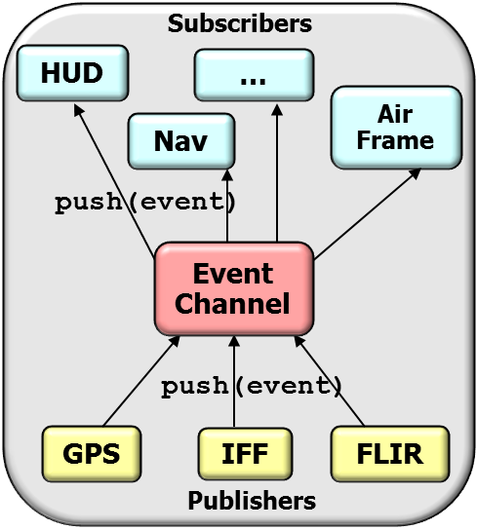
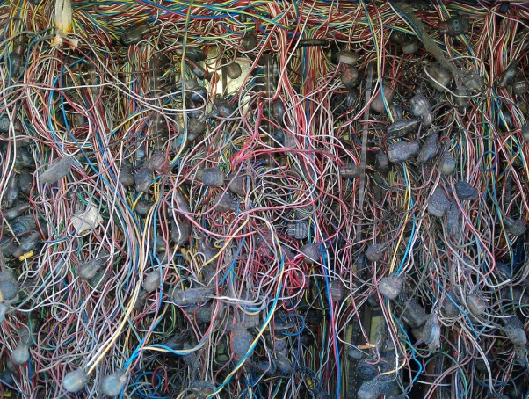
Isolating Communication Concerns
Context | Problems
Avionics control systems needs IPC Stringent quality-of-service (QoS) requirements | Shield app developers from: Low-level message passing Network computing diversity Inherent networking complexities
Broker Revisited:www.kircher-schwanninger.de/michael/publications/BrokerRevisited.pdf
Notes:
http://www.flickr.com/photos/49149363@N00/414160195/

Slide 40
Isolating Communication Concerns
Context | Problems | Solution
Avionics control systems needs IPC Stringent quality-of-service (QoS) requirements | Shield app developers from: Low-level message passing Network computing diversity Inherent networking complexities | Apply Broker pattern to isolate apps from communication concerns between processor boards
Structure
Object Adapter
Broker connects clients with remote objects by mediating invocations from clients to these objects, while encapsulating low-level communication details

Slide 41
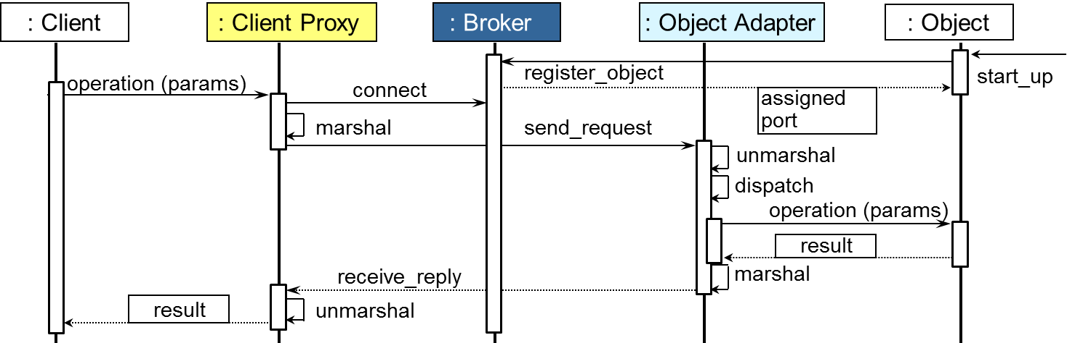
Isolating Communication Concerns
Context | Problems | Solution
Avionics control systems needs IPC Stringent quality-of-service (QoS) requirements | Shield app developers from: Low-level message passing Network computing diversity Inherent networking complexities | Apply Broker pattern to isolate apps from communication concerns between processor boards
Dynamics

Slide 42
Applying the Broker Pattern
6: Subscribers
perform
avionics
operations
This pattern shielded pub/sub apps from effects of infrastructure heterogeneity, e.g.,
Programming languages
Operating systems
Networking protocols
Hardware
Subscribers
HUD
Nav
…
Air Frame
5: Event Channel
pushes events
to subscriber(s)
push(event)
Event Channel
4: Sensor
publishers
push events
to event
channel
push(event)
GPS
IFF
FLIR
3: Broker
handles I/O
via upcalls
Publishers
Broker
2: I/O via interrupts
1: Sensors
generate
data
Board 1
VME
Board 2
1553
www.dre.vanderbilt.edu/~schmidt/corba-research-realtime.html has more info

Slide 43
Applying the Broker Pattern
6: Subscribers
perform
avionics
operations
This pattern shielded pub/sub apps from effects of infrastructure heterogeneity, e.g.,
Programming languages
Operating systems
Networking protocols
Hardware
Subscribers
HUD
Nav
…
Air Frame
5: Event Channel
pushes events
to subscriber(s)
push(event)
Event Channel
4: Sensor
publishers
push events
to event
channel
push(event)
GPS
IFF
FLIR
3: Broker
handles I/O
via upcalls
Key implementation considerations:
Real-time end-to-end QoS support
e.g., bounded latency/jitter, priority preservation, etc.
Publishers
Broker
2: I/O via interrupts
1: Sensors
generate
data
Board 1
VME
Board 2
1553
www.dre.vanderbilt.edu/~schmidt/corba-research-realtime.html has more info

Slide 44
Applying the Broker Pattern
6: Subscribers
perform
avionics
operations
This pattern shielded pub/sub apps from effects of infrastructure heterogeneity, e.g.,
Programming languages
Operating systems
Networking protocols
Hardware
Subscribers
HUD
Nav
…
Air Frame
5: Event Channel
pushes events
to subscriber(s)
push(event)
Event Channel
4: Sensor
publishers
push events
to event
channel
push(event)
GPS
IFF
FLIR
3: Broker
handles I/O
via upcalls
Key implementation considerations:
Real-time end-to-end QoS support
e.g., bounded latency/jitter, priority preservation, etc.
Other ‘ilities’
e.g., dependability, security, etc.
Publishers
Broker
2: I/O via interrupts
1: Sensors
generate
data
Board 1
VME
Board 2
1553
www.dre.vanderbilt.edu/~schmidt/corba-research-realtime.html has more info

Slide 45

Some Patterns Used to Implement Brokers
Subscribers
The collaboration between the Publisher-Subscriber & Broker patterns in our avionics control system example underscores that patterns aren’t islands
HUD
Nav
…
Air Frame
push(event)
Event Channel
push(event)
GPS
IFF
FLIR
Publishers
Broker
Board 1
VME
Board 2
1553

Slide 46
Some Patterns Used to Implement Brokers
The collaboration between the Publisher-Subscriber & Broker patterns in our avionics control system example underscores that patterns aren’t islands
We’ll now summarize other patterns commonly used to implement the Broker pattern
<<ENCODES>>
<<DECODES>>
Proxy
Adapter
Layers
<<CREATES HANDLERS>>
Half-Sync/ Half-Async
<<CREATES HANDLERS>>
Connector
Acceptor
Monitor Object
<<CONTAINS>>
<<CONTAINS>>
<<SYNCHRONIZES>>
Reactor
<<CONTAINS>>
Strategy
<<CONTAINS>>
Abstract Factory
Component Configurator
<<LINKS>>
<<CREATES>>
Wrapper Facade
<<ENCAPSULATES>>

Slide 47
Some Patterns Used to Implement Brokers
Client
Object/Servant
The collaboration between the Publisher-Subscriber & Broker patterns in our avionics control system example underscores that patterns aren’t islands
We’ll now summarize other patterns commonly used to implement the Broker pattern
Patterns first presented in context of a CORBA broker implementation
Then covered in more detail & in other contexts later
<<ENCODES>>
Skel
<<DECODES>>
Stub
Proxy
Adapter
Layers
ORB Core
<<CREATES HANDLERS>>
Half-Sync/ Half-Async
<<CREATES HANDLERS>>
Connector
Acceptor
Monitor Object
<<CONTAINS>>
<<CONTAINS>>
<<SYNCHRONIZES>>
Reactor
<<CONTAINS>>
Strategy
<<CONTAINS>>
Abstract Factory
Component Configurator
<<LINKS>>
<<CREATES>>
Wrapper Facade
OS APIs
OS APIs
<<ENCAPSULATES>>
www.dre.vanderbilt.edu/~schmidt/PDF/ORB-patterns.pdf has more info

Slide 48
Some Patterns Used to Implement Brokers
Client
Object/Servant
Layers structures internal design
<<ENCODES>>
Skel
<<DECODES>>
Stub
Proxy
Adapter
Layers
ORB Core
<<CREATES HANDLERS>>
Half-Sync/ Half-Async
<<CREATES HANDLERS>>
Connector
Acceptor
Monitor Object
<<CONTAINS>>
<<CONTAINS>>
<<SYNCHRONIZES>>
Reactor
<<CONTAINS>>
Strategy
<<CONTAINS>>
Abstract Factory
Component Configurator
<<LINKS>>
<<CREATES>>
Wrapper Facade
OS APIs
OS APIs
<<ENCAPSULATES>>
posa1.blogspot.com/2008/05/layered-architecture-pattern.html has more info

Slide 49
Some Patterns Used to Implement Brokers
Client
Object/Servant
Layers structures internal design
Wrapper Facades enhances portability
<<ENCODES>>
Skel
<<DECODES>>
Stub
Proxy
Adapter
Layers
ORB Core
<<CREATES HANDLERS>>
Half-Sync/ Half-Async
<<CREATES HANDLERS>>
Connector
Acceptor
Monitor Object
<<CONTAINS>>
<<CONTAINS>>
<<SYNCHRONIZES>>
Reactor
<<CONTAINS>>
Strategy
<<CONTAINS>>
Abstract Factory
Component Configurator
<<LINKS>>
<<CREATES>>
Wrapper Facade
OS APIs
OS APIs
<<ENCAPSULATES>>
See www.dre.vanderbilt.edu/~schmidt/PDF/wrapper-facade.pdf for more info

Slide 50
Some Patterns Used to Implement Brokers
Client
Object/Servant
Layers structures internal design
Wrapper Facades enhances portability
Proxies & Adapters simplify client & server apps
<<ENCODES>>
Skel
<<DECODES>>
Stub
Proxy
Adapter
Layers
ORB Core
<<CREATES HANDLERS>>
Half-Sync/ Half-Async
<<CREATES HANDLERS>>
Connector
Acceptor
Monitor Object
<<CONTAINS>>
<<CONTAINS>>
<<SYNCHRONIZES>>
Reactor
<<CONTAINS>>
Strategy
<<CONTAINS>>
Abstract Factory
Component Configurator
<<LINKS>>
<<CREATES>>
Wrapper Facade
OS APIs
OS APIs
<<ENCAPSULATES>>
See en.wikipedia.org/wiki/Proxy_pattern & en.wikipedia.org/wiki/Adapter_pattern

Slide 51
Some Patterns Used to Implement Brokers
Client
Object/Servant
Layers structures internal design
Wrapper Facades enhances portability
Proxies & Adapters simplify client & server apps
Component Configurator configures Factories
<<ENCODES>>
Skel
<<DECODES>>
Stub
Proxy
Adapter
Layers
ORB Core
<<CREATES HANDLERS>>
Half-Sync/ Half-Async
<<CREATES HANDLERS>>
Connector
Acceptor
Monitor Object
<<CONTAINS>>
<<CONTAINS>>
<<SYNCHRONIZES>>
Reactor
<<CONTAINS>>
Strategy
<<CONTAINS>>
Abstract Factory
Component Configurator
<<LINKS>>
<<CREATES>>
Wrapper Facade
OS APIs
OS APIs
<<ENCAPSULATES>>
www.dre.vanderbilt.edu/~schmidt/PDF/Svc-Conf.pdf has more info

Slide 52
Some Patterns Used to Implement Brokers
Client
Object/Servant
Layers structures internal design
Wrapper Facades enhances portability
Proxies & Adapters simplify client & server apps
Component Configurator configures Factories
Factories produce Strategies
<<ENCODES>>
Skel
<<DECODES>>
Stub
Proxy
Adapter
Layers
ORB Core
<<CREATES HANDLERS>>
Half-Sync/ Half-Async
<<CREATES HANDLERS>>
Connector
Acceptor
Monitor Object
<<CONTAINS>>
<<CONTAINS>>
<<SYNCHRONIZES>>
Reactor
<<CONTAINS>>
Strategy
<<CONTAINS>>
Abstract Factory
Component Configurator
<<LINKS>>
<<CREATES>>
Wrapper Facade
OS APIs
OS APIs
<<ENCAPSULATES>>
See en.wikipedia.org/wiki/Abstract_factory_pattern for Abstract Factory pattern

Slide 53
Some Patterns Used to Implement Brokers
Client
Object/Servant
Layers structures internal design
Wrapper Facades enhances portability
Proxies & Adapters simplify client & server apps
Component Configurator configures Factories
Factories produce Strategies
Strategies implement Broker mechanisms
<<ENCODES>>
Skel
<<DECODES>>
Stub
Proxy
Adapter
Layers
ORB Core
<<CREATES HANDLERS>>
Half-Sync/ Half-Async
<<CREATES HANDLERS>>
Connector
Acceptor
Monitor Object
<<CONTAINS>>
<<CONTAINS>>
<<SYNCHRONIZES>>
Reactor
<<CONTAINS>>
Strategy
<<CONTAINS>>
Abstract Factory
Component Configurator
<<LINKS>>
<<CREATES>>
Wrapper Facade
OS APIs
OS APIs
<<ENCAPSULATES>>
en.wikipedia.org/wiki/Strategy_pattern has more on the Strategy pattern

Slide 54
Some Patterns Used to Implement Brokers
Client
Object/Servant
Layers structures internal design
Wrapper Facades enhances portability
Proxies & Adapters simplify client & server apps
Component Configurator configures Factories
Factories produce Strategies
Strategies implement Broker mechanisms
Concurrency strategies may be Reactor & Half-Sync/Half-Async
<<ENCODES>>
Skel
<<DECODES>>
Stub
Proxy
Adapter
Layers
ORB Core
<<CREATES HANDLERS>>
Half-Sync/ Half-Async
<<CREATES HANDLERS>>
Connector
Acceptor
Monitor Object
<<CONTAINS>>
<<CONTAINS>>
<<SYNCHRONIZES>>
Reactor
<<CONTAINS>>
Strategy
<<CONTAINS>>
Abstract Factory
Component Configurator
<<LINKS>>
<<CREATES>>
Wrapper Facade
OS APIs
OS APIs
<<ENCAPSULATES>>
See Reactor.pdf & HS-HA.pdf at www.dre.vanderbilt.edu/~schmidt/PDF

Slide 55
Some Patterns Used to Implement Brokers
Client
Object/Servant
Layers structures internal design
Wrapper Facades enhances portability
Proxies & Adapters simplify client & server apps
Component Configurator configures Factories
Factories produce Strategies
Strategies implement Broker mechanisms
Concurrency strategies may be Reactor & Half-Sync/Half-Async
Monitor Object synchronizes concurrent method calls
<<ENCODES>>
Skel
<<DECODES>>
Stub
Proxy
Adapter
Layers
ORB Core
<<CREATES HANDLERS>>
Half-Sync/ Half-Async
<<CREATES HANDLERS>>
Connector
Acceptor
Monitor Object
<<CONTAINS>>
<<CONTAINS>>
<<SYNCHRONIZES>>
Reactor
<<CONTAINS>>
Strategy
<<CONTAINS>>
Abstract Factory
Component Configurator
<<LINKS>>
<<CREATES>>
Wrapper Facade
OS APIs
OS APIs
<<ENCAPSULATES>>
See www.dre.vanderbilt.edu/~schmidt/PDF/monitor.pdf for Monitor Object

Slide 56
Some Patterns Used to Implement Brokers
Client
Object/Servant
Layers structures internal design
Wrapper Facades enhances portability
Proxies & Adapters simplify client & server apps
Component Configurator configures Factories
Factories produce Strategies
Strategies implement Broker mechanisms
Concurrency strategies may be Reactor & Half-Sync/Half-Async
Monitor Object synchronizes concurrent method calls
Acceptor-Connector decouples connection management from request processing
<<ENCODES>>
Skel
<<DECODES>>
Stub
Proxy
Adapter
Layers
ORB Core
<<CREATES HANDLERS>>
Half-Sync/ Half-Async
<<CREATES HANDLERS>>
Connector
Acceptor
Monitor Object
<<CONTAINS>>
<<CONTAINS>>
<<SYNCHRONIZES>>
Reactor
<<CONTAINS>>
Strategy
<<CONTAINS>>
Abstract Factory
Component Configurator
<<LINKS>>
<<CREATES>>
Wrapper Facade
OS APIs
OS APIs
<<ENCAPSULATES>>
www.dre.vanderbilt.edu/~schmidt/PDF/Acc-Con.pdf for Acceptor-Connector

Slide 57
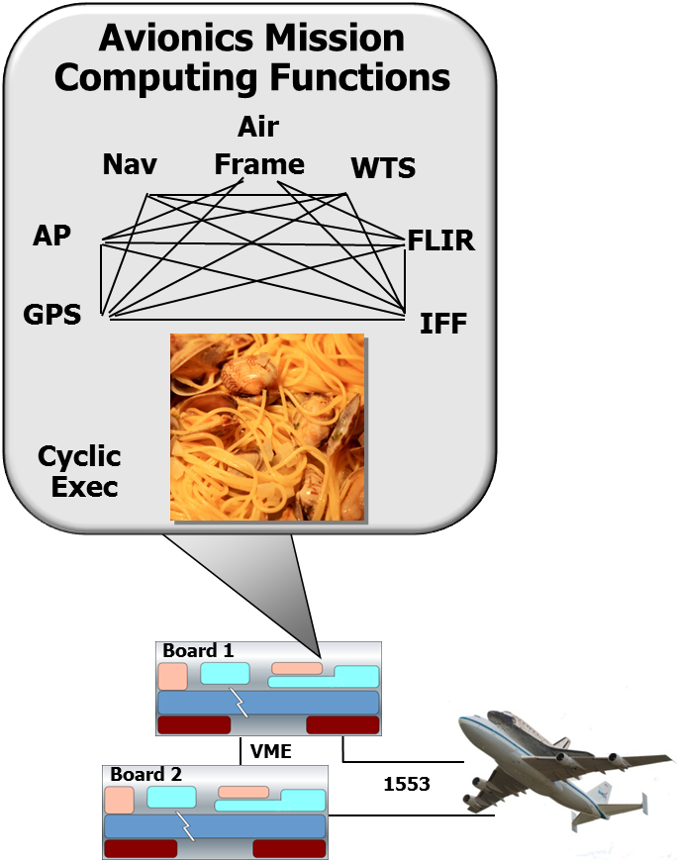
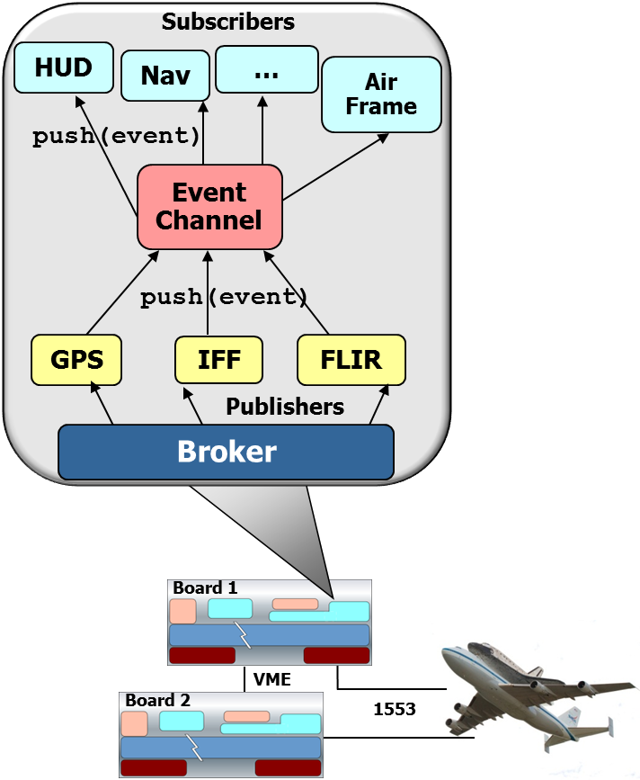
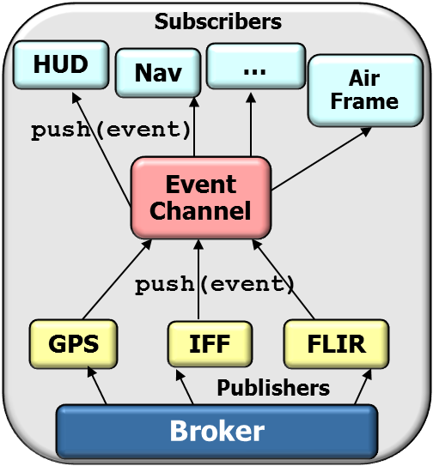
Summary
Patterns help overcome limitations with traditional avionics control system architectures (& concurrent & networked systems in general)
We’ll explore relationships between many patterns in later parts
Notes:
http://www.flickr.com/photos/58925091@N00/166368185/

Slide 58
Overview of Pattern Relationships: Part 3
Douglas C. Schmidt
d.schmidt@vanderbilt.edu
www.dre.vanderbilt.edu/~schmidt
Professor of Computer Science
Institute for Software Integrated Systems Vanderbilt University Nashville, Tennessee, USA

Slide 59
Topics Covered in this Part of the Module
Motivate the need for pattern relationships above & beyond pattern collections
Outline the common types of pattern relationships
Describe key concurrent & networked software patterns associated with the avionics domain
Describe common types of pattern relationships:
Pattern complements
Pattern compounds
We’ll also summarize various relevant GoF & POSA patterns
Notes:
http://www.flickr.com/photos/82439748@N00/1155311612/,

Slide 60
Overview of Pattern Complements
One pattern provides missing ingredient needed by another to make resulting designs more complete & balanced

Slide 61
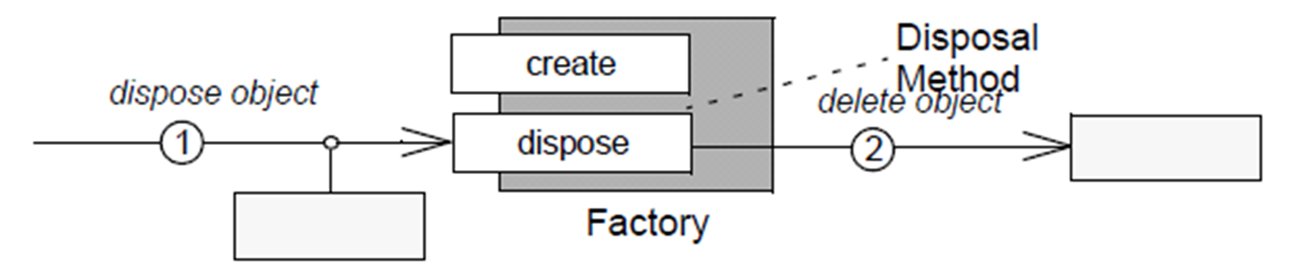
Overview of Pattern Complements
One pattern provides missing ingredient needed by another to make resulting designs more complete & balanced
e.g., Disposal Method complements Factory Method by addressing object destruction & creation
Encapsulate concrete details of object disposal by providing an explicit method to clean up
Provide an interface for creating families of related objects without specifying their concrete classes
Factory Method
See wiki.hsr.ch/APF/files/BeyondtheGangofFour.pdf for more info
Notes:
See wiki.hsr.ch/APF/files/BeyondtheGangofFour.pdf for more info

Slide 62
Overview of Pattern Complements
One pattern provides missing ingredient needed by another to make resulting designs more complete & balanced
e.g., Disposal Method complements Factory Method by addressing object destruction & creation
CORBA Portable Object Adapter (POA) is a manager for object lifecycles & a demuxer that maps client requests to object implementations
Factory Method
create_POA
destroy
CORBA POA
See www.dre.vanderbilt.edu/~schmidt/PDF/POA.pdf for more info

Slide 63
Overview of Pattern Complements
Or one pattern competes with another by providing an alternative solution to a related problem
Notes:
http://www.flickr.com/photos/27446438@N07/4846712316/

Slide 64
Overview of Pattern Complements
Or one pattern competes with another by providing an alternative solution to a related problem
e.g., Batch Method competes with Iterator by accessing elements of aggregates in bulk, thereby reducing communication costs
See adtmag.com/articles/2001/09/24/a-tale-of-three-patterns.aspx for more
Notes:
http://www.flickr.com/photos/27446438@N07/4846712316/

Slide 65
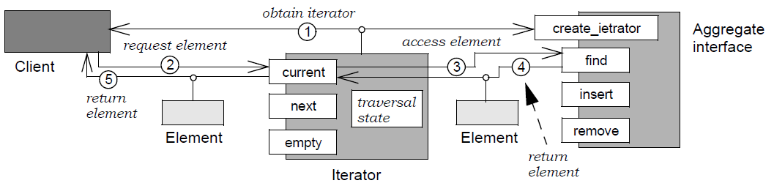
Overview of Pattern Complements
Or one pattern competes with another by providing an alternative solution to a related problem
e.g., Batch Method competes with Iterator by accessing elements of aggregates in bulk, thereby reducing communication costs
Access elements of an aggregate without exposing its representation
create_iterator
See adtmag.com/articles/2001/09/24/a-tale-of-three-patterns.aspx for more
Notes:
http://www.flickr.com/photos/27446438@N07/4846712316/

Slide 66
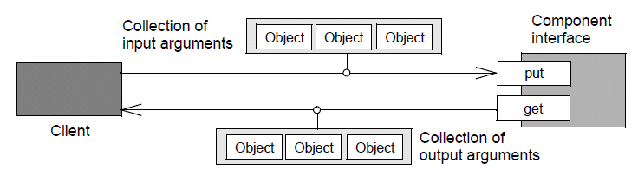
Overview of Pattern Complements
Or one pattern competes with another by providing an alternative solution to a related problem
e.g., Batch Method competes with Iterator by accessing elements of aggregates in bulk, thereby reducing communication costs
Group multiple collection accesses together to reduce cost of multiple individual accesses in a latency-sensitive context
Batch Method
See adtmag.com/articles/2001/09/24/a-tale-of-three-patterns.aspx for more
Notes:
http://www.flickr.com/photos/27446438@N07/4846712316/

Slide 67
Overview of Pattern Compounds
Pattern compounds capture recurring subcommunities of patterns that are common & identifiable enough to treat them as a single decision in response to a recurring problem

Slide 68
Overview of Pattern Compounds
Pattern compounds capture recurring subcommunities of patterns that are common & identifiable enough to treat them as a single decision in response to a recurring problem
e.g., Composite Command encapsulates requests as an object, hiding differences between single requests & multiple requests behind a common interface
Composite
Command

Slide 69
Overview of Pattern Compounds
Pattern compounds capture recurring subcommunities of patterns that are common & identifiable enough to treat them as a single decision in response to a recurring problem
e.g., Composite Command encapsulates requests as an object, hiding differences between single requests & multiple requests behind a common interface
Composite
Command
Collection of Request parameters
Request
…
Client
Component Interface
composite_command

Slide 70
Overview of Pattern Compounds
Pattern compounds capture recurring subcommunities of patterns that are common & identifiable enough to treat them as a single decision in response to a recurring problem
e.g., Composite Command encapsulates requests as an object, hiding differences between single requests & multiple requests behind a common interface
CORBA’s send_multiple _requests_oneway() operation initiates a variable # of requests in parallel & doesn’t wait for requests to finish before returning to the caller
Collection of Request parameters
Request
…
Client
ORB
send_multiple_requests_oneway

Slide 71
Overview of Pattern Compounds
Pattern compounds capture recurring subcommunities of patterns that are common & identifiable enough to treat them as a single decision in response to a recurring problem
e.g., Batch Iterator brings together competing pattern complements— Iterator & Batch Method—to remotely access elements of aggregates containing large # of elements
Batch (Method)
Iterator

Slide 72
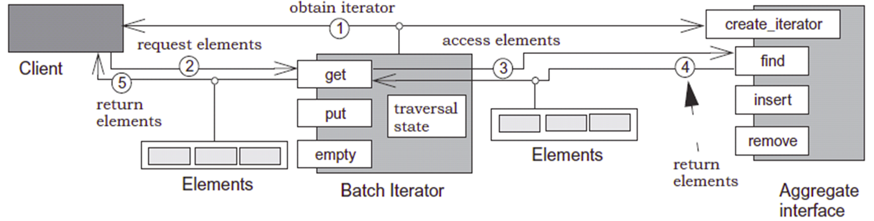
Overview of Pattern Compounds
Pattern compounds capture recurring subcommunities of patterns that are common & identifiable enough to treat them as a single decision in response to a recurring problem
e.g., Batch Iterator brings together competing pattern complements— Iterator & Batch Method—to remotely access elements of aggregates containing large # of elements
Batch (Method)
Iterator

Slide 73
Overview of Pattern Compounds
Pattern compounds capture recurring subcommunities of patterns that are common & identifiable enough to treat them as a single decision in response to a recurring problem
e.g., Batch Iterator brings together competing pattern complements— Iterator & Batch Method—to remotely access elements of aggregates containing large # of elements
CORBA’s Naming Service provides a Batch Iterator (called BindingIterator) that enables bulk access of many—but not all—elements in a NamingContext
list
next_n
next_n
next_one
bind
destroy
unbind
BindingIterator
Naming Context

Slide 74
Summary
Pattern complements & pattern compounds are initial steps towards moving away from patterns as distinct islands of design to parts of an interwoven whole
Notes:
http://www.flickr.com/photos/58925091@N00/166368185/

Slide 75
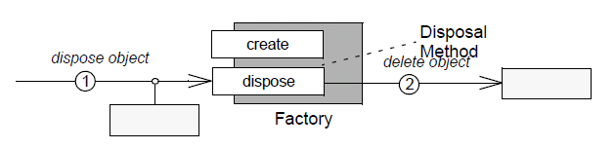
Summary
Pattern complements & pattern compounds are initial steps towards moving away from patterns as distinct islands of design to parts of an interwoven whole
A pattern complement completes the design of another pattern
Factory Method
Notes:
http://www.flickr.com/photos/58925091@N00/166368185/

Slide 76
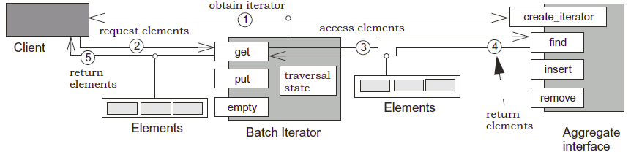
Summary
Pattern complements & pattern compounds are initial steps towards moving away from patterns as distinct islands of design to parts of an interwoven whole
A pattern complement completes the design of another pattern
A pattern compound names a commonly recurring, cohesive combination of other patterns
Notes:
http://www.flickr.com/photos/58925091@N00/166368185/

Slide 77
Summary
Pattern complements & pattern compounds are initial steps towards moving away from patterns as distinct islands of design to parts of an interwoven whole
A pattern complement completes the design of another pattern
A pattern compound names a commonly recurring, cohesive combination of other patterns
The POSA5 book gives an in-depth discussion of the key concepts underlying pattern complements & pattern compounds
These patterns apply to much more than CORBA & avionics control systems!
Notes:
http://www.flickr.com/photos/58925091@N00/166368185/

Slide 78
Overview of Pattern Relationships: Part 4
Douglas C. Schmidt
d.schmidt@vanderbilt.edu
www.dre.vanderbilt.edu/~schmidt
Professor of Computer Science
Institute for Software Integrated Systems Vanderbilt University Nashville, Tennessee, USA

Slide 79
Topics Covered in this Part of the Module
Motivate the need for pattern relationships above & beyond pattern collections
Outline the common types of pattern relationships
Describe key concurrent & networked software patterns associated with the avionics domain
Describe common types of pattern relationships:
Pattern complements
Pattern compounds
Pattern sequences
We’ll summarize yet more relevant GoF & POSA patterns
Notes:
http://www.flickr.com/photos/82439748@N00/1155311612/,

Slide 80
Overview of Pattern Sequences
Pattern sequences generalize the progression of patterns & the way a design can be established by joining predecessor patterns with successor patterns to form part of their context
Notes:
http://commons.wikimedia.org/wiki/File:DNA_Double_Helix.png

Slide 81
Overview of Pattern Sequences
Broker
Pattern sequences generalize the progression of patterns & the way a design can be established by joining predecessor patterns with successor patterns to form part of their context
A pattern sequence captures the unfolding of a design pattern-by- pattern
Component Configurator
Strategy
Half-Sync/ Half-Async
Abstract Factory
Reactor
Monitor Object
Layers
Acceptor- Connector
Wrapper Facade
Notes:
http://commons.wikimedia.org/wiki/File:DNA_Double_Helix.png

Slide 82

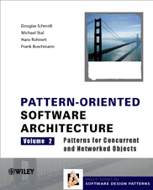
Overview of Pattern Sequences
Pattern sequences generalize the progression of patterns & the way a design can be established by joining predecessor patterns with successor patterns to form part of their context
A pattern sequence captures the unfolding of a design pattern-by- pattern
e.g., POSA2 & POSA4 present pattern sequences for communication middleware
Pattern | Problem
Layers | Structuring broker internal design to enable reuse & clean separation of concerns
Wrapper Façade | Encapsulating low-level system functions to enhance portability
Reactor | Demuxing broker core events efficiently
Acceptor- Connector | Managing broker connections efficiently
Half-Sync/ Half-Async | Enhancing broker scalability by processing requests concurrently
Monitor Object | Efficiently synchronize the Half-Sync/Async request queue
Strategy | Interchanging internal broker mechanisms transparently
Abstract Factory | Consolidating broker mechanisms into groups of semantically compatible strategies
Component Configurator | Configuring consolidated broker strategies dynamically
… | …
Broker | Defining the broker’s base-line architecture

Slide 83
Overview of Pattern Sequences
Pattern sequences generalize the progression of patterns & the way a design can be established by joining predecessor patterns with successor patterns to form part of their context
A pattern sequence captures the unfolding of a design pattern-by- pattern
e.g., POSA2 & POSA4 present pattern sequences for communication middleware
Pattern | Problem
Layers | Structuring broker internal design to enable reuse & clean separation of concerns
Wrapper Façade | Encapsulating low-level system functions to enhance portability
Reactor | Demuxing broker core events efficiently
Acceptor- Connector | Managing broker connections efficiently
Half-Sync/ Half-Async | Enhancing broker scalability by processing requests concurrently
Monitor Object | Efficiently synchronize the Half-Sync/Async request queue
Strategy | Interchanging internal broker mechanisms transparently
Abstract Factory | Consolidating broker mechanisms into groups of semantically compatible strategies
Component Configurator | Configuring consolidated broker strategies dynamically
… | …
Broker | Defining the broker’s base-line architecture

Slide 84
Enhancing Broker Flexibility with Strategy
Context | Problem
Multi-domain reusable Broker framework | No “one-size-fits-all” Broker configuration applies to all use cases Ad hoc variation is messy
if (do_thread)
// acquire lock
…
if (do_thread)
// release lock
Skel
if (do_perfect_hash)
// …
else if (do_binary_search)
// …
Stub
Demuxing code
ORB Core
Synchronization code
if (do_IIOP)
// …
else if (do_shared_memory)
// …
Request transport code
OS APIs
OS APIs

Slide 85
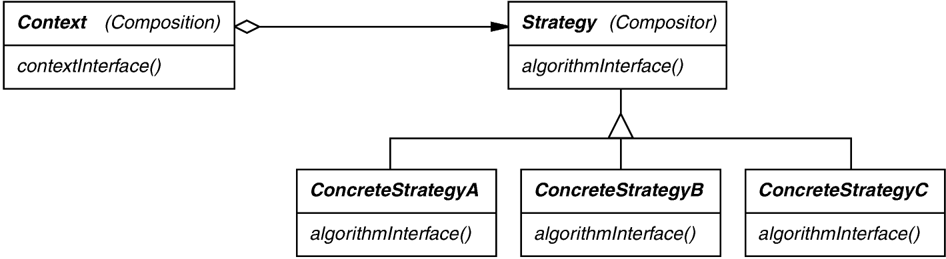
Enhancing Broker Flexibility with Strategy
Context | Problem | Solution
Multi-domain reusable Broker framework | No “one-size-fits-all” Broker configuration applies to all use cases Ad hoc variation is messy | Apply the Strategy pattern to factory out commonality amongst various Broker implementation mechanisms
Structure
Strategy defines a family of algorithms, encapsulates each one, & makes them interchangeable
See en.wikipedia.org/wiki/Strategy_pattern for info on Strategy

Slide 86
Enhancing Broker Flexibility with Strategy
Context | Problem | Solution
Multi-domain reusable Broker framework | No “one-size-fits-all” Broker configuration applies to all use cases Ad hoc variation is messy | Apply the Strategy pattern to factory out commonality amongst various Broker implementation mechanisms
(De)marshaling strategy
(De)marshaling strategy
Request demuxing strategy
Connection management strategy
Request transport strategy
Concurrency strategy
Synchronization strategy
Event demuxing strategy
See en.wikipedia.org/wiki/Strategy_pattern for info on Strategy

Slide 87
Consolidating Strategies with Abstract Factory
Context | Problem
A heavily strategized Broker framework | It’s hard to ensure that only semantically-compatible strategies are configured into a framework
Thread pool concurrency strategy
Null-Lock Synchronization strategy
Reactive event demuxing strategy

Slide 88
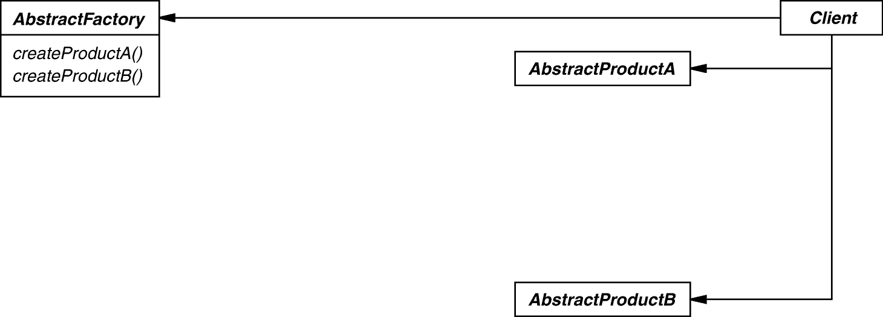
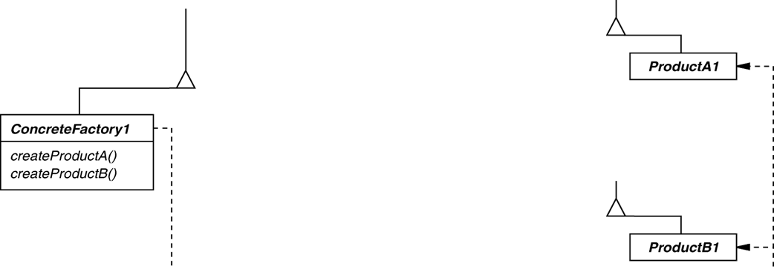
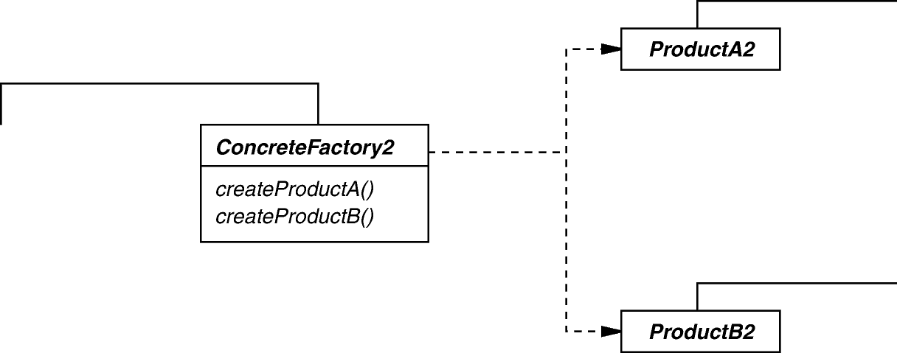
Consolidating Strategies with Abstract Factory
Context | Problem | Solution
A heavily strategized Broker framework | It’s hard to ensure that only semantically-compatible strategies are configured into a framework | Apply Abstract Factory pattern to consolidate Broker strategies into semantically-compatible configurations
Structure
Factory Methods
Abstract Factory creates families of related objects without exposing subclass names
en.wikipedia.org/wiki/Abstract_factory_pattern has more on Abstract Factory

Slide 89
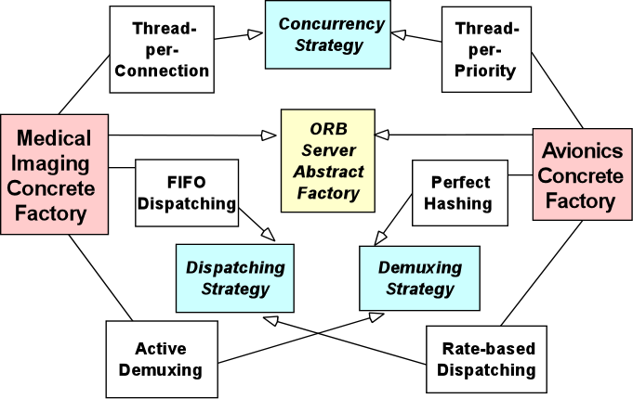
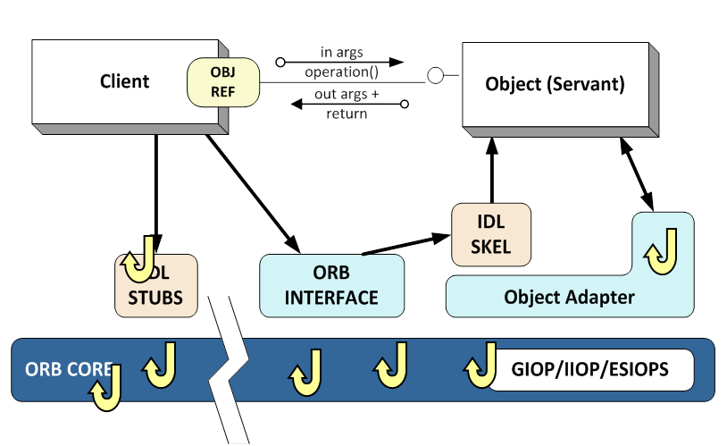
Consolidating Strategies with Abstract Factory
Context | Problem | Solution
A heavily strategized Broker framework | It’s hard to ensure that only semantically-compatible strategies are configured into a framework | Apply Abstract Factory pattern to consolidate Broker strategies into semantically-compatible configurations
Broker Abstract Factory

Slide 90
Configuring Factories w/Component Configurator
Context | Problem
Resource limited and/or dynamic setting | Prematurely committing to a Broker configuration is inflexible & inefficient since certain decisions can’t be made at design-time & apps incur overhead for components they don’t use/need
IDL Stub
IDL Skel
ORB Interface
Object Adapter
ORB Core
GIOP/IIOP

Slide 91
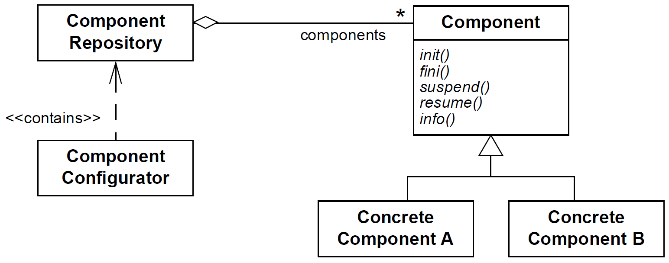
Configuring Factories w/Component Configurator
Context | Problem | Solution
Resource limited and/or dynamic setting | Prematurely committing to a Broker configuration is inflexible & inefficient since certain decisions can’t be made at design-time & apps incur overhead for components they don’t use/need | Apply Component Configurator pattern to assemble the desired Broker factories & strategies dynamically
Structure
Component Configurator decouples component interfaces from their implementations & can reconfigure components without having to shutdown & restart
<<contains>>
See www.dre.vanderbilt.edu/~schmidt/PDF/Svc-Conf.pdf for more info

Slide 92
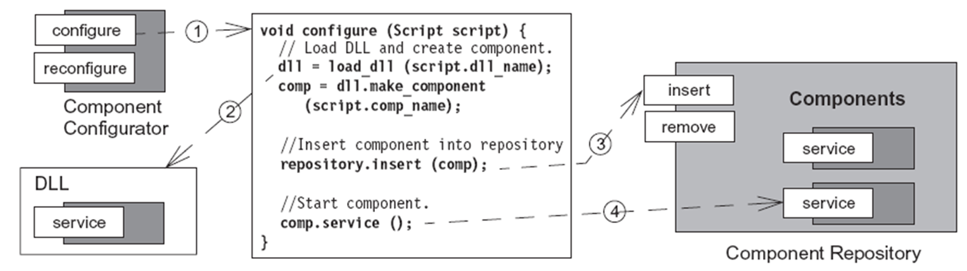
Configuring Factories w/Component Configurator
Context | Problem | Solution
Resource limited and/or dynamic setting | Prematurely committing to a Broker configuration is inflexible & inefficient since certain decisions can’t be made at design-time & apps incur overhead for components they don’t use/need | Apply Component Configurator pattern to assemble the desired Broker factories & strategies dynamically
Dynamics
See www.dre.vanderbilt.edu/~schmidt/PDF/Svc-Conf.pdf for more info

Slide 93
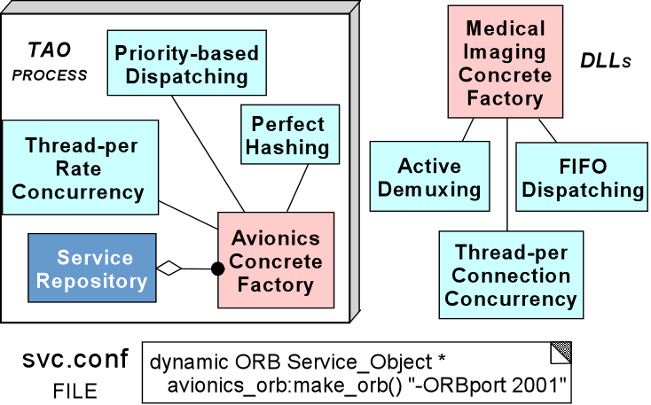
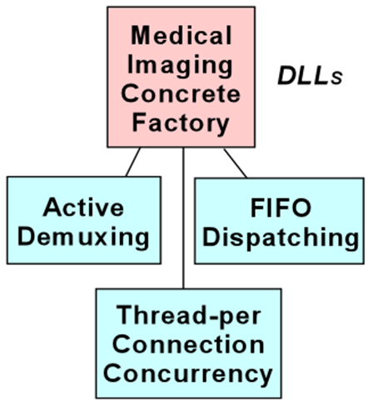
Configuring Factories w/Component Configurator
Context | Problem | Solution
Resource limited and/or dynamic setting | Prematurely committing to a Broker configuration is inflexible & inefficient since certain decisions can’t be made at design-time & apps incur overhead for components they don’t use/need | Apply Component Configurator pattern to assemble the desired Broker factories & strategies dynamically
Broker process
Shared libraries residing in persistent storage

Slide 94
Summary
A pattern sequence is both a process & a thing
It represents a process composed of constituent patterns arranged in an order that captures the evolution of a system & achieves a particular design outcome
Pattern | Problem
Layers | Structuring broker internal design to enable reuse & clean separation of concerns
Wrapper Façade | Encapsulating low-level system functions to enhance portability
Reactor | Demuxing broker Core events efficiently
Acceptor- Connector | Managing broker connections efficiently
Half-Sync/ Half-Async | Enhancing broker scalability by processing requests concurrently
Monitor Object | Efficiently synchronize the Half-Sync/Async request queue
Strategy | Interchanging internal broker mechanisms transparently
Abstract Factory | Consolidating broker mechanisms into groups of semantically compatible strategies
Component Configurator | Configuring consolidated broker strategies dynamically
… | …
Broker | Defining the broker’s base-line architecture
Notes:
http://www.flickr.com/photos/58925091@N00/166368185/

Slide 95
Summary
A pattern sequence is both a process & a thing
It represents a process composed of constituent patterns arranged in an order that captures the evolution of a system & achieves a particular design outcome
Pattern | Problem
Layers | Structuring broker internal design to enable reuse & clean separation of concerns
Wrapper Façade | Encapsulating low-level system functions to enhance portability
Reactor | Demuxing broker Core events efficiently
Acceptor- Connector | Managing broker connections efficiently
Half-Sync/ Half-Async | Enhancing broker scalability by processing requests concurrently
Monitor Object | Efficiently synchronize the Half-Sync/Async request queue
Strategy | Interchanging internal broker mechanisms transparently
Abstract Factory | Consolidating broker mechanisms into groups of semantically compatible strategies
Component Configurator | Configuring consolidated broker strategies dynamically
… | …
Broker | Defining the broker’s base-line architecture
Note the combination of GoF & POSA patterns in this sequence
Notes:
http://www.flickr.com/photos/58925091@N00/166368185/

Slide 96
Summary
Component Configurator
A pattern sequence is both a process & a thing
It represents a process composed of constituent patterns arranged in an order that captures the evolution of a system & achieves a particular design outcome
Consequences of one pattern in a sequence generate forces that must be resolved by another pattern
Dynamically configure only factories/strategies actually used
Statically configured factories & strategies may be inefficient
Abstract Factory
Ensures semantically-compatible strategy configurations
Can create a configuration nightmare from too many strategy combinations
Factors out common interface to pluggable broker mechanisms
Strategy
These patterns apply to much more than CORBA & avionics control systems!
Notes:
http://www.flickr.com/photos/58925091@N00/166368185/

Slide 97
Overview of Pattern Relationships: Part 5
Douglas C. Schmidt
d.schmidt@vanderbilt.edu
www.dre.vanderbilt.edu/~schmidt
Professor of Computer Science
Institute for Software Integrated Systems Vanderbilt University Nashville, Tennessee, USA

Slide 98
Topics Covered in this Part of the Module
Motivate the need for pattern relationships above & beyond pattern collections
Outline the common types of pattern relationships
Describe key concurrent & networked software patterns associated with the avionics domain
Describe common types of pattern relationships:
Pattern complements
Pattern compounds
Pattern sequences
Pattern languages (overview)
We’ll summarize even more relevant GoF & POSA patterns
Notes:
http://www.flickr.com/photos/82439748@N00/1155311612/,

Slide 99
Overview of Pattern Languages
A pattern language is a network of related patterns
<<ENCODES>>
<<DECODES>>
Proxy
Adapter
Layers
<<CREATES HANDLERS>>
Half-Sync/ Half-Async
<<CREATES HANDLERS>>
Connector
Acceptor
Monitor Object
<<CONTAINS>>
<<CONTAINS>>
<<SYNCHRONIZES>>
Reactor
<<CONTAINS>>
Strategy
<<CONTAINS>>
Abstract Factory
Component Configurator
<<LINKS>>
<<CREATES>>
Wrapper Facade
<<ENCAPSULATES>>

Slide 100
Overview of Pattern Languages
A pattern language is a network of related patterns
It defines a vocabulary
i.e., the patterns themselves
<<ENCODES>>
<<DECODES>>
Proxy
Adapter
Layers
<<CREATES HANDLERS>>
Half-Sync/ Half-Async
<<CREATES HANDLERS>>
Connector
Acceptor
Monitor Object
<<CONTAINS>>
<<CONTAINS>>
<<SYNCHRONIZES>>
Reactor
<<CONTAINS>>
Strategy
<<CONTAINS>>
Abstract Factory
Component Configurator
<<LINKS>>
<<CREATES>>
Wrapper Facade
<<ENCAPSULATES>>

Slide 101
Overview of Pattern Languages
A pattern language is a network of related patterns
It defines a vocabulary
i.e., the patterns themselves
It defines a process for systematically resolving development problems that arise in a domain
The domain might be a software domain or some other domain
Client
Object/Servant
<<ENCODES>>
Skel
<<DECODES>>
Stub
Proxy
Adapter
Layers
ORB Core
<<CREATES HANDLERS>>
Half-Sync/ Half-Async
<<CREATES HANDLERS>>
Connector
Acceptor
Monitor Object
<<CONTAINS>>
<<CONTAINS>>
<<SYNCHRONIZES>>
Reactor
<<CONTAINS>>
Strategy
<<CONTAINS>>
Abstract Factory
Component Configurator
<<LINKS>>
<<CREATES>>
Wrapper Facade
OS APIs
OS APIs
<<ENCAPSULATES>>
This sounds a lot like pattern sequences, but there are important differences

Slide 102
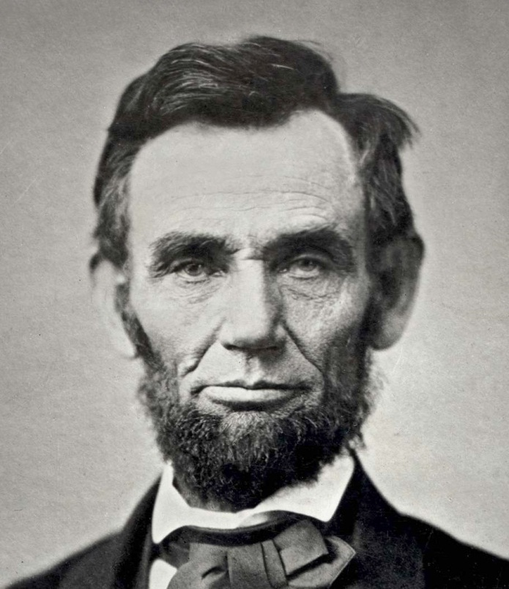

Comparing Patterns, Sequences, & Languages
A pattern is to a pattern sequence as a photograph is to a traditional film
i.e., a pattern sequence is a linearized presentation of related patterns
Notes:
http://upload.wikimedia.org/wikipedia/commons/b/be/Film_strip.jpg, http://en.wikipedia.org/wiki/File:Abraham_Lincoln_November_1863.jpg

Slide 103

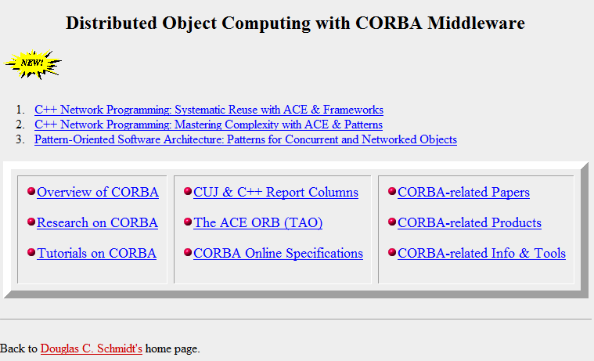
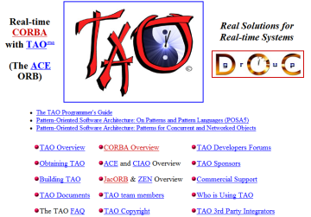
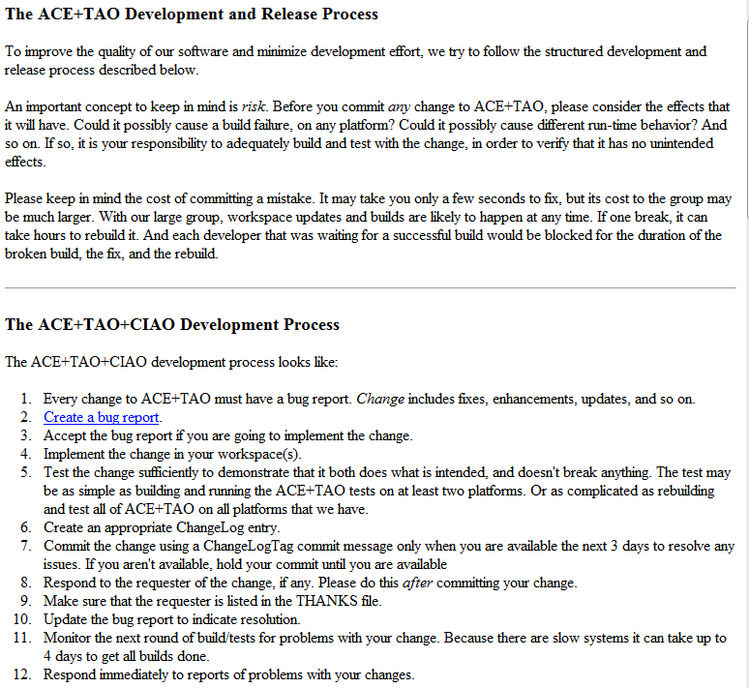
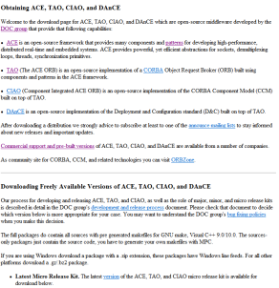
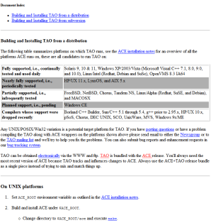
Comparing Patterns, Sequences, & Languages
A pattern is to a pattern sequence as a photograph is to a traditional film
i.e., a pattern sequence is a linearized presentation of related patterns
A pattern sequence is to a pattern language as a traditional film is to a “hyperlink cinema” film or hypertext document
i.e., a pattern language is a network of patterns that can be traversed in different ways
See en.wikipedia.org/wiki/Hyperlink_cinema for info on hyperlink cinema
Notes:
http://upload.wikimedia.org/wikipedia/commons/b/be/Film_strip.jpg, http://en.wikipedia.org/wiki/File:Abraham_Lincoln_November_1863.jpg

Slide 104
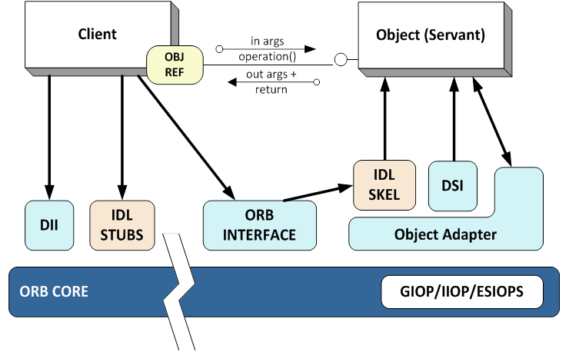
Contrasting Pattern Sequences & Languages
The patterns in a pattern sequence are arranged in an order that captures the evolution of a system & achieves a particular design outcome
Layers
Wrapper Facade
Reactor
Acceptor- Connector
Half-Sync/ Half-Async
Broker
Component Configurator
Abstract Factory
Strategy
Monitor Object
This pattern sequence for Broker is not comprehensive

Slide 105
Contrasting Pattern Sequences & Languages
The patterns in a pattern sequence are arranged in an order that captures the evolution of a system & achieves a particular design outcome
Layers
Wrapper Facade
Reactor
Acceptor- Connector
Half-Sync/ Half-Async
Broker
Component Configurator
Abstract Factory
Strategy
Monitor Object
posa1.blogspot.com/2008/05/layered-architecture-pattern.html has more info

Slide 106
Contrasting Pattern Sequences & Languages
The patterns in a pattern sequence are arranged in an order that captures the evolution of a system & achieves a particular design outcome
Layers
Wrapper Facade
Reactor
Acceptor- Connector
Half-Sync/ Half-Async
Broker
Component Configurator
Abstract Factory
Strategy
Monitor Object
See www.dre.vanderbilt.edu/~schmidt/PDF/wrapper-facade.pdf for more info

Slide 107
Contrasting Pattern Sequences & Languages
The patterns in a pattern sequence are arranged in an order that captures the evolution of a system & achieves a particular design outcome
Layers
Wrapper Facade
Reactor
Acceptor- Connector
Half-Sync/ Half-Async
Broker
Component Configurator
Abstract Factory
Strategy
Monitor Object
See www.dre.vanderbilt.edu/~schmidt/PDF/Reactor.pdf for Reactor pattern

Slide 108
Contrasting Pattern Sequences & Languages
The patterns in a pattern sequence are arranged in an order that captures the evolution of a system & achieves a particular design outcome
Layers
Wrapper Facade
Reactor
Acceptor- Connector
Half-Sync/ Half-Async
Broker
Component Configurator
Abstract Factory
Strategy
Monitor Object
www.dre.vanderbilt.edu/~schmidt/PDF/Acc-Con.pdf has Acceptor-Connector

Slide 109
Contrasting Pattern Sequences & Languages
The patterns in a pattern sequence are arranged in an order that captures the evolution of a system & achieves a particular design outcome
Layers
Wrapper Facade
Reactor
Acceptor- Connector
Half-Sync/ Half-Async
Broker
Component Configurator
Abstract Factory
Strategy
Monitor Object
www.dre.vanderbilt.edu/~schmidt/PDF/HS-HA.pdf has Half-Sync/Half-Async

Slide 110
Contrasting Pattern Sequences & Languages
The patterns in a pattern sequence are arranged in an order that captures the evolution of a system & achieves a particular design outcome
Layers
Wrapper Facade
Reactor
Acceptor- Connector
Half-Sync/ Half-Async
Broker
Component Configurator
Abstract Factory
Strategy
Monitor Object
www.dre.vanderbilt.edu/~schmidt/PDF/monitor.pdf for Monitor Object

Slide 111
Contrasting Pattern Sequences & Languages
The patterns in a pattern sequence are arranged in an order that captures the evolution of a system & achieves a particular design outcome
Layers
Wrapper Facade
Reactor
Acceptor- Connector
Half-Sync/ Half-Async
Broker
Component Configurator
Abstract Factory
Strategy
Monitor Object
en.wikipedia.org/wiki/Strategy_pattern has more on the Strategy pattern

Slide 112
Contrasting Pattern Sequences & Languages
The patterns in a pattern sequence are arranged in an order that captures the evolution of a system & achieves a particular design outcome
Layers
Wrapper Facade
Reactor
Acceptor- Connector
Half-Sync/ Half-Async
Broker
Component Configurator
Abstract Factory
Strategy
Monitor Object
See en.wikipedia.org/wiki/Abstract_factory_pattern for Abstract Factory pattern

Slide 113
Contrasting Pattern Sequences & Languages
The patterns in a pattern sequence are arranged in an order that captures the evolution of a system & achieves a particular design outcome
Layers
Wrapper Facade
Reactor
Acceptor- Connector
Half-Sync/ Half-Async
Broker
Component Configurator
Abstract Factory
Strategy
Monitor Object
www.dre.vanderbilt.edu/~schmidt/PDF/Svc-Conf.pdf has more info

Slide 114
Contrasting Pattern Sequences & Languages
The patterns in a pattern sequence are arranged in an order that captures the evolution of a system & achieves a particular design outcome
Layers
Wrapper Facade
Reactor
Acceptor- Connector
Half-Sync/ Half-Async
Broker
Component Configurator
Abstract Factory
Strategy
Monitor Object
Broker Revisited:www.kircher-schwanninger.de/michael/publications/BrokerRevisited.pdf

Slide 115
Contrasting Pattern Sequences & Languages
The patterns in a pattern sequence are arranged in an order that captures the evolution of a system & achieves a particular design outcome
The patterns in a pattern language build on each other to help generate a system by documenting a successive progression of design decisions, transformations, & alternatives
Layers
Wrapper Facade
Acceptor- Connector
Reactor
Monitor Object
Half-Sync/ Half-Async
Acceptor- Connector
Leader/ Followers
Component Configurator
Abstract Factory
Strategy
Broker
This pattern language for Broker is not comprehensive

Slide 116
Contrasting Pattern Sequences & Languages
The patterns in a pattern sequence are arranged in an order that captures the evolution of a system & achieves a particular design outcome
The patterns in a pattern language build on each other to help generate a system by documenting a successive progression of design decisions, transformations, & alternatives
Layers
Wrapper Facade
Acceptor- Connector
Reactor
Monitor Object
Half-Sync/ Half-Async
Acceptor- Connector
Leader/ Followers
Component Configurator
Abstract Factory
Strategy
Broker
Simplicity

Slide 117
Contrasting Pattern Sequences & Languages
The patterns in a pattern sequence are arranged in an order that captures the evolution of a system & achieves a particular design outcome
The patterns in a pattern language build on each other to help generate a system by documenting a successive progression of design decisions, transformations, & alternatives
Layers
Wrapper Facade
Acceptor- Connector
Reactor
Monitor Object
Half-Sync/ Half-Async
Acceptor- Connector
Leader/ Followers
Component Configurator
Abstract Factory
Strategy
Broker
Simplicity & Flexibility

Slide 118
Contrasting Pattern Sequences & Languages
The patterns in a pattern sequence are arranged in an order that captures the evolution of a system & achieves a particular design outcome
The patterns in a pattern language build on each other to help generate a system by documenting a successive progression of design decisions, transformations, & alternatives
Layers
Wrapper Facade
Acceptor- Connector
Reactor
Monitor Object
Half-Sync/ Half-Async
Acceptor- Connector
Leader/ Followers
Component Configurator
Abstract Factory
Strategy
Broker
Scalability & Flexibility

Slide 119
Contrasting Pattern Sequences & Languages
The patterns in a pattern sequence are arranged in an order that captures the evolution of a system & achieves a particular design outcome
The patterns in a pattern language build on each other to help generate a system by documenting a successive progression of design decisions, transformations, & alternatives
Layers
Wrapper Facade
Acceptor- Connector
Reactor
Monitor Object
Half-Sync/ Half-Async
Acceptor- Connector
Leader/ Followers
Component Configurator
Abstract Factory
Strategy
Broker
Predictability & Flexibility

Slide 120
Contrasting Pattern Sequences & Languages
The patterns in a pattern sequence are arranged in an order that captures the evolution of a system & achieves a particular design outcome
The patterns in a pattern language build on each other to help generate a system by documenting a successive progression of design decisions, transformations, & alternatives
Steps in devising & applying a pattern language involve determining
What are key problems to resolve & in what order
Problem
…
Enhancing broker scalability by processing requests concurrently
Efficiently synchronizing request queues
Interchanging internal broker mechanisms transparently
Consolidating broker mechanisms into groups of semantically compatible strategies
Configuring consolidated broker strategies dynamically
…

Slide 121
Contrasting Pattern Sequences & Languages
The patterns in a pattern sequence are arranged in an order that captures the evolution of a system & achieves a particular design outcome
The patterns in a pattern language build on each other to help generate a system by documenting a successive progression of design decisions, transformations, & alternatives
Steps in devising & applying a pattern language involve determining
What are key problems to resolve & in what order
How should mutual dependencies between problems be handled
Problem
…
Enhancing broker scalability by processing requests concurrently
Efficiently synchronizing request queues
Interchanging internal broker mechanisms transparently
Consolidating broker mechanisms into groups of semantically compatible strategies
Configuring consolidated broker strategies dynamically
…

Slide 122
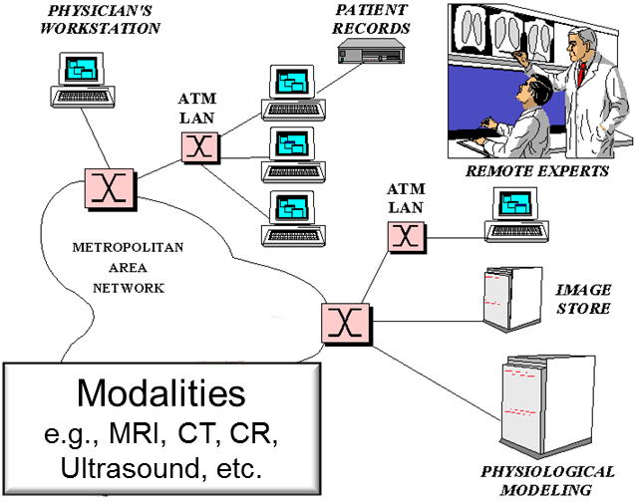

Contrasting Pattern Sequences & Languages
The patterns in a pattern sequence are arranged in an order that captures the evolution of a system & achieves a particular design outcome
The patterns in a pattern language build on each other to help generate a system by documenting a successive progression of design decisions, transformations, & alternatives
Steps in devising & applying a pattern language involve determining
What are key problems to resolve & in what order
How should mutual dependencies between problems be handled
How to resolve each individual problem most effectively in its context

Slide 123
Contrasting Pattern Sequences & Languages
The patterns in a pattern sequence are arranged in an order that captures the evolution of a system & achieves a particular design outcome
The patterns in a pattern language build on each other to help generate a system by documenting a successive progression of design decisions, transformations, & alternatives
Steps in devising & applying a pattern language involve determining
What are key problems to resolve & in what order
How should mutual dependencies between problems be handled
How to resolve each individual problem most effectively in its context
What alternatives exist for resolving each problem
?
Reactor
Which broker concurrency alternative to choose
?
?
Half-Sync/ Half-Async
Leader/ Followers

Slide 124
Summary
Pattern languages integrate groups of related patterns to enable larger-scale reuse of software architecture & design
Key is their ability to navigate through alternatives in the design space
Layers
Wrapper Facade
Acceptor- Connector
Reactor
Monitor Object
Half-Sync/ Half-Async
Acceptor- Connector
Leader/ Followers
Component Configurator
Abstract Factory
Strategy
Broker

Slide 125
Overview of Pattern Relationships: Part 6
Douglas C. Schmidt
d.schmidt@vanderbilt.edu
www.dre.vanderbilt.edu/~schmidt
Professor of Computer Science
Institute for Software Integrated Systems Vanderbilt University Nashville, Tennessee, USA

Slide 126
Topics Covered in this Part of the Module
Motivate the need for pattern relationships above & beyond pattern collections
Outline the common types of pattern relationships
Describe key concurrent & networked software patterns associated with the avionics domain
Describe common types of pattern relationships:
Pattern complements
Pattern compounds
Pattern sequences
Pattern languages (detailed example)
We’ll summarize even more relevant GoF & POSA patterns
Notes:
http://www.flickr.com/photos/82439748@N00/1155311612/,

Slide 127
Recap of Our Pattern Language Thus Far
The patterns in our pattern language build on each other to help generate a Broker implementation by documenting a successive progression of design decisions, transformations, & alternatives
Layers
Wrapper Facade
Acceptor- Connector
Reactor
Monitor Object
Half-Sync/ Half-Async
Acceptor- Connector
Leader/ Followers
Component Configurator
Abstract Factory
Strategy
?
?
Broker
?
Which Broker concurrency alternative to choose
This pattern language for Broker is not comprehensive
Notes:
Simplicity
Scalability
Predictability

Slide 128
Simplifying Event Handling with Reactor
Context | Problem
Avionics control system with stringent QoS needs | Developers often tightly couple event demuxing & connection code with protocol-handling code
Hard-coded to a particular system call
select (width, &ready_handles, 0, 0, 0);
if (FD_ISSET (acceptor, &ready_handles)) {
int h = accept (acceptor, 0, 0);
FD_SET (handle, &ready_handles);
// ... Handle connection acceptance
} else
for (int handle = s_handle + 1; handle < maxhandlep1; ++handle)
if (FD_ISSET (handle, &ready_handles)) {
// ... Perform application protocol processing
}
Use of non-portable handle type
Inefficient O(n) sequential search

Slide 129
Simplifying Event Handling with Reactor
Context | Problem | Solution
Avionics control system with stringent QoS needs | Developers often tightly couple event demuxing & connection code with protocol-handling code | Apply Reactor to separate generic event demuxing & connection management code from Broker protocol code
Structure
Reactor structures event-driven software to cleanly demux & dispatch service requests delivered from one or more clients
<<uses>>
See www.dre.vanderbilt.edu/~schmidt/PDF/Reactor.pdf for more on Reactor
Notes:
http://cpp.ezbty.org/content/science_doc/libevent%E6%BA%90%E7%A0%81%E6%B7%B1%E5%BA%A6%E5%89%96%E6%9E%90%EF%BC%9Areactor%E6%A8%A1%E5%BC%8F

Slide 130
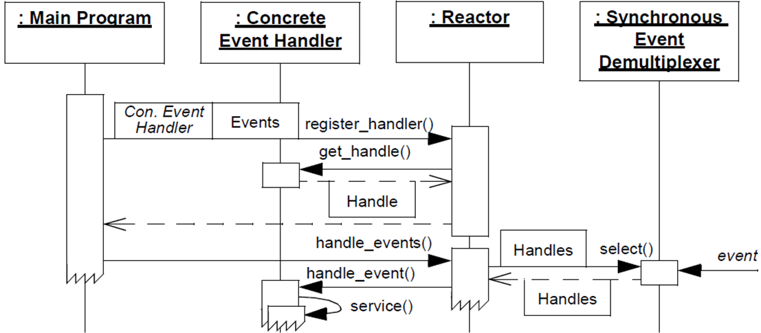
Simplifying Event Handling with Reactor
Context | Problem | Solution
Avionics control system with stringent QoS needs | Developers often tightly couple event demuxing & connection code with protocol-handling code | Apply Reactor to separate generic event demuxing & connection management code from Broker protocol code
Dynamics
Reactor structures event-driven software to cleanly demux & dispatch service requests delivered from one or more clients
See www.dre.vanderbilt.edu/~schmidt/PDF/Reactor.pdf for more on Reactor
Notes:
http://cpp.ezbty.org/content/science_doc/libevent%E6%BA%90%E7%A0%81%E6%B7%B1%E5%BA%A6%E5%89%96%E6%9E%90%EF%BC%9Areactor%E6%A8%A1%E5%BC%8F

Slide 131
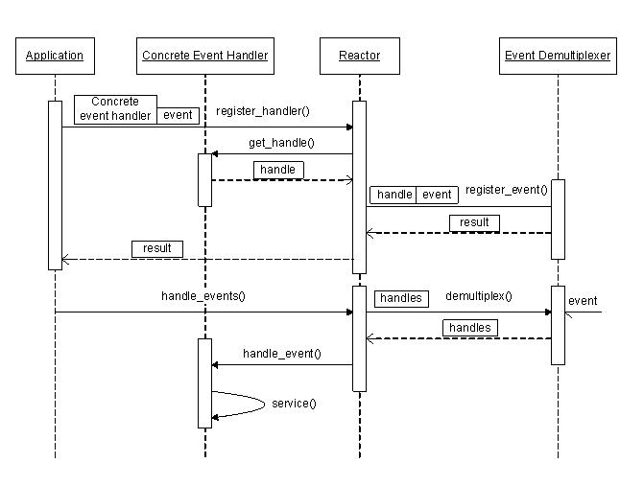

Slide 132
Simplifying Event Handling with Reactor
Context | Problem | Solution
Avionics control system with stringent QoS needs | Developers often tightly couple event demuxing & connection code with protocol-handling code | Apply Reactor to separate generic event demuxing & connection management code from Broker protocol code
Object
(Servant)
Root POA
Object Adapter
IIOP Handlers & Acceptors
ORB Core
Reactor
<<ready to read>>
Socket Event Sources
Reactor provides coarse-grained concurrency control

Slide 133


Enhancing Scalability with Half-Sync/Half-Async
Context | Problem
Avionics control system with stringent QoS needs | To improve QoS for all connected clients, a Broker process must take advantage of parallelism & not block while waiting for connection flow control to abate
Root POA
IIOP Handlers & Acceptors
Reactor
<<ready to read>>
Socket Event Sources

Slide 134

Enhancing Scalability with Half-Sync/Half-Async
Context | Problem | Solution
Avionics control system with stringent QoS needs | To improve QoS for all connected clients, a Broker process must take advantage of parallelism & not block while waiting for connection flow control to abate | Apply Half-Sync/ Half-Async to scalably process requests concurrently in a pool of threads
Structure
Half-Sync/Half-Async decouples async & sync processing in concurrent systems to simplify programming without unduly reducing performance
www.dre.vanderbilt.edu/~schmidt/PDF/HS-HA.pdf has more on this pattern

Slide 135

Enhancing Scalability with Half-Sync/Half-Async
Context | Problem | Solution
Avionics control system with stringent QoS needs | To improve QoS for all connected clients, a Broker process must take advantage of parallelism & not block while waiting for connection flow control to abate | Apply Half-Sync/ Half-Async to scalably process requests concurrently in a pool of threads
Dynamics
Half-Sync/Half-Async decouples async & sync processing in concurrent systems to simplify programming without unduly reducing performance

Slide 136
Enhancing Scalability with Half-Sync/Half-Async
Context | Problem | Solution
Avionics control system with stringent QoS needs | To improve QoS for all connected clients, a Broker process must take advantage of parallelism & not block while waiting for connection flow control to abate | Apply Half-Sync/ Half-Async to scalably process requests concurrently in a pool of threads
Object
(Servant)
POA Thread Pool
Lane 1
Lane 2
Lane 3
Object Adapter
IIOP Handlers & Acceptors
ORB Core
Reactor
<<ready to read>>
Socket Event Sources
Half-Sync/Half-Async enables multiple requests to run concurrently

Slide 137
Enhancing Predictability with Leader/Followers
Context | Problem
Avionics control system with stringent QoS needs | Although Half-Sync/Half-Async is more scalable than a pure Reactor model, it incurs higher memory management, synchronization, context switching, & data movement overhead
POA Thread Pool
Dynamic memory (de)allocation
Lane 1
Lane 2
Lane 3
IIOP Handlers & Acceptors
Reactor
<<ready to read>>
Socket Event Sources

Slide 138
Enhancing Predictability with Leader/Followers
Context | Problem
Avionics control system with stringent QoS needs | Although Half-Sync/Half-Async is more scalable than a pure Reactor model, it incurs higher memory management, synchronization, context switching, & data movement overhead
POA Thread Pool
Dynamic memory (de)allocation
Synchronization operations
Lane 1
Lane 2
Lane 3
IIOP Handlers & Acceptors
Reactor
<<ready to read>>
Socket Event Sources

Slide 139
Enhancing Predictability with Leader/Followers
Context | Problem
Avionics control system with stringent QoS needs | Although Half-Sync/Half-Async is more scalable than a pure Reactor model, it incurs higher memory management, synchronization, context switching, & data movement overhead
POA Thread Pool
Dynamic memory (de)allocation
Synchronization operations
Context switches
Lane 1
Lane 2
Lane 3
IIOP Handlers & Acceptors
Reactor
<<ready to read>>
Socket Event Sources

Slide 140
Enhancing Predictability with Leader/Followers
Context | Problem
Avionics control system with stringent QoS needs | Although Half-Sync/Half-Async is more scalable than a pure Reactor model, it incurs higher memory management, synchronization, context switching, & data movement overhead
POA Thread Pool
Dynamic memory (de)allocation
Synchronization operations
Context switches
CPU cache updates
Lane 1
Lane 2
Lane 3
IIOP Handlers & Acceptors
Reactor
<<ready to read>>
Socket Event Sources

Slide 141
Enhancing Predictability with Leader/Followers
Context | Problem | Solution
Avionics control system with stringent QoS needs | Although Half-Sync/Half-Async is more scalable than a pure Reactor model, it incurs higher memory management, synchronization, context switching, & data movement overhead | Apply Leader/ Followers pattern to reduce thread jitter & overhead
Structure
Thread Pool
demultiplexes
synchronizer
Leader/Follower provides an efficient concurrency model where multiple threads take turns sharing event sources to process service requests that occur on the event sources
join()
promote_new_leader()
*
Event Handler
handle_event ()
get_handle()
Handle
*
Handle Set
handle_events()
deactivate_handle()
reactivate_handle()
select()
Concrete Event Handler A
Concrete Event Handler B
handle_event ()
get_handle()
handle_event ()
get_handle()
See www.dre.vanderbilt.edu/~schmidt/PDF/LF.pdf for more info on this pattern
Notes:
http://www.cnblogs.com/xmpp/archive/2013/02/19/2916816.html

Slide 142

Enhancing Predictability with Leader/Followers
Context | Problem | Solution
Avionics control system with stringent QoS needs | Although Half-Sync/Half-Async is more scalable than a pure Reactor model, it incurs higher memory management, synchronization, context switching, & data movement overhead | Apply Leader/ Followers pattern to reduce thread jitter & overhead
Dynamics
Leader/Follower provides an efficient concurrency model where multiple threads take turns sharing event sources to process service requests that occur on the event sources
Notes:
http://www.cnblogs.com/xmpp/archive/2013/02/19/2916816.html

Slide 143
Enhancing Predictability with Leader/Followers
Context | Problem | Solution
Avionics control system with stringent QoS needs | Although Half-Sync/Half-Async is more scalable than a pure Reactor model, it incurs higher memory management, synchronization, context switching, & data movement overhead | Apply Leader/ Followers pattern to reduce thread jitter & overhead
Object
(Servant)
POA Thread Pool
Lane 1
Lane 2
Lane 3
Object Adapter
IIOP Handlers & Acceptors
ORB Core
Thread Pool Reactor
<<ready to read>>
Socket Event Sources
Eliminates overhead of separate reactor thread & synchronized request queue

Slide 144
Summary
Pattern languages integrate groups of related patterns to enable larger-scale reuse of software architecture & design
Key is their ability to navigate through alternatives in the design space
Layers
Wrapper Facade
Acceptor- Connector
Reactor
Monitor Object
Half-Sync/ Half-Async
Acceptor- Connector
Leader/ Followers
Component Configurator
Abstract Factory
Strategy
Broker
Simplicity

Slide 145
Summary
Pattern languages integrate groups of related patterns to enable larger-scale reuse of software architecture & design
Key is their ability to navigate through alternatives in the design space
Layers
Wrapper Facade
Acceptor- Connector
Reactor
Monitor Object
Half-Sync/ Half-Async
Acceptor- Connector
Leader/ Followers
Component Configurator
Abstract Factory
Strategy
Broker
Scalability & flexibility

Slide 146
Summary
Pattern languages integrate groups of related patterns to enable larger-scale reuse of software architecture & design
Key is their ability to navigate through alternatives in the design space
Layers
Wrapper Facade
Acceptor- Connector
Reactor
Monitor Object
Half-Sync/ Half-Async
Acceptor- Connector
Leader/ Followers
Component Configurator
Abstract Factory
Strategy
Broker
Predictability & Flexibility

Slide 147

Summary
Pattern languages integrate groups of related patterns to enable larger-scale reuse of software architecture & design
Extensive pattern languages are now documented
POSA4 pattern language for distributed computing relates 114 patterns in 13 topics areas
POSA5 describes key concepts of pattern languages

Slide 148

Summary
Pattern languages integrate groups of related patterns to enable larger-scale reuse of software architecture & design
Extensive pattern languages are now documented
POSA4 pattern language for distributed computing relates 114 patterns in 13 topics areas
POSA5 describes key concepts of pattern languages
Developing/learning pattern languages is hard, but they express the most powerful & elegant pattern relationships for software developers & teams

